Slide 1
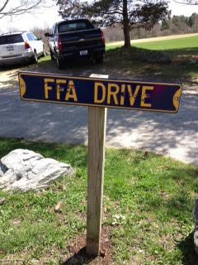
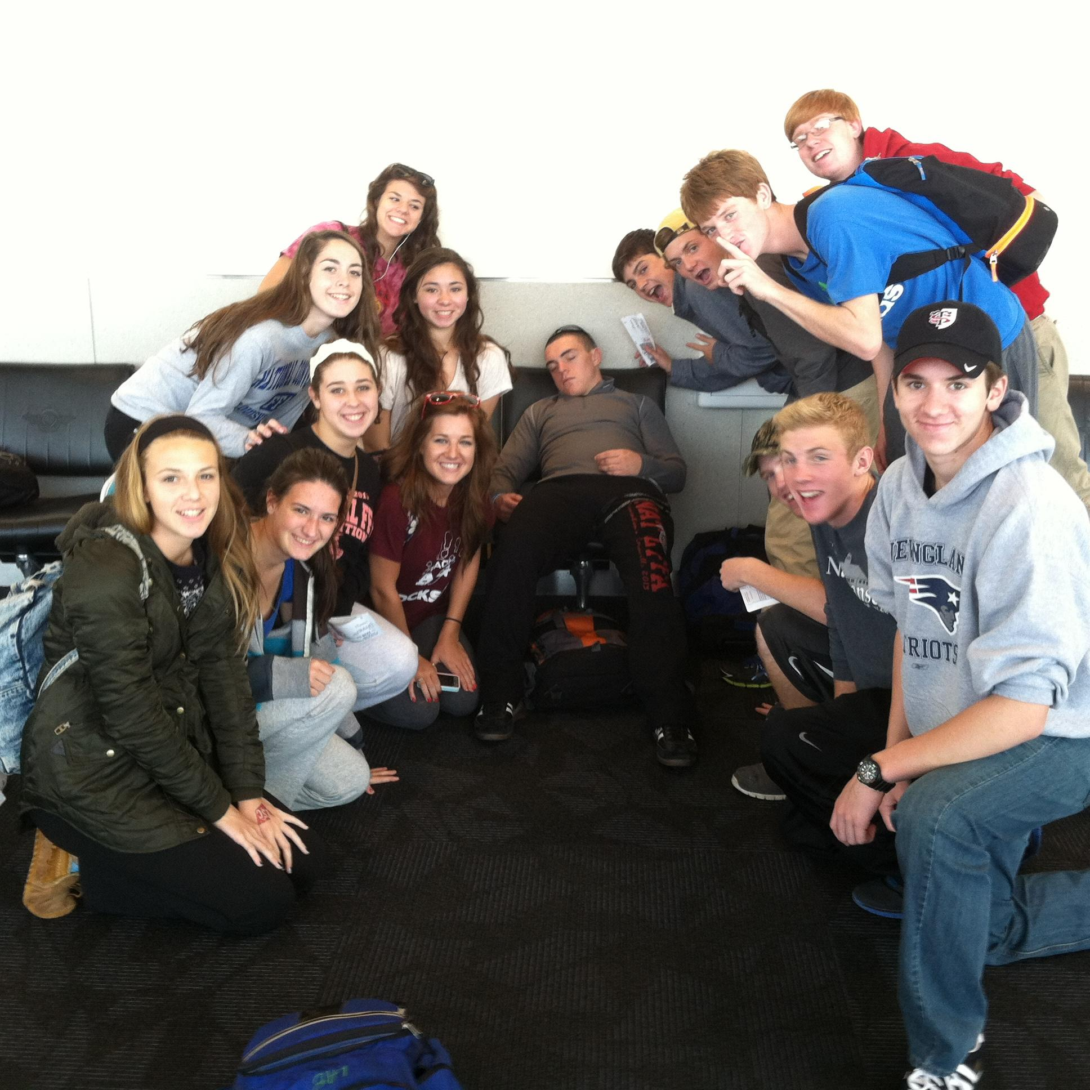
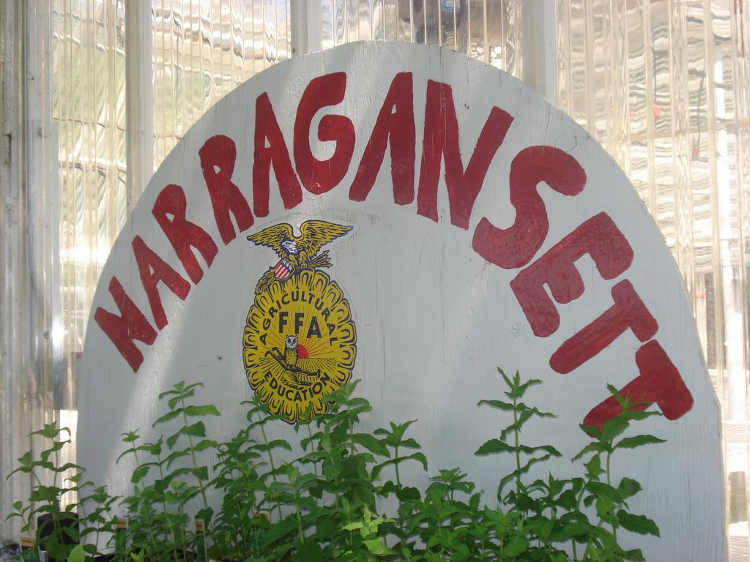
THE AGRISCIENCE DEPARTMENT & NARRAGANSETT FFA:

Slide 2
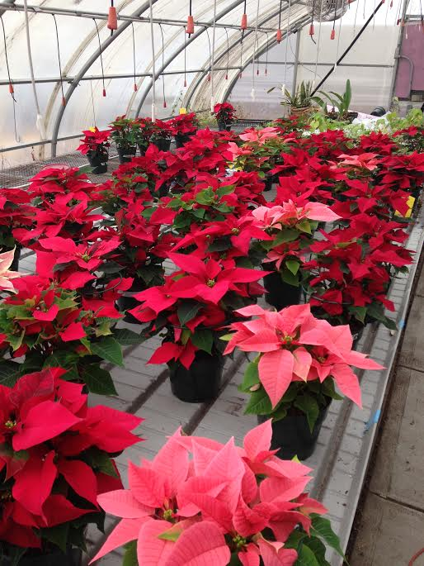
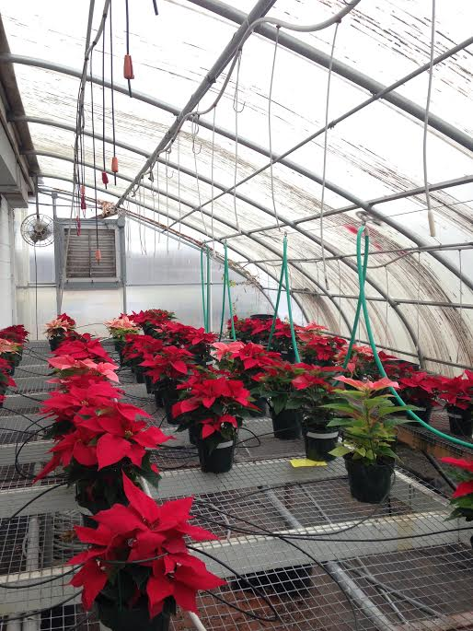
Our Greenhouses (in the winter):
We grow mums and poinsettias to sell to the public during the fall and winter months. Students learn the skills for proper greenhouse management as they help care for and learn about these plants.

Slide 3
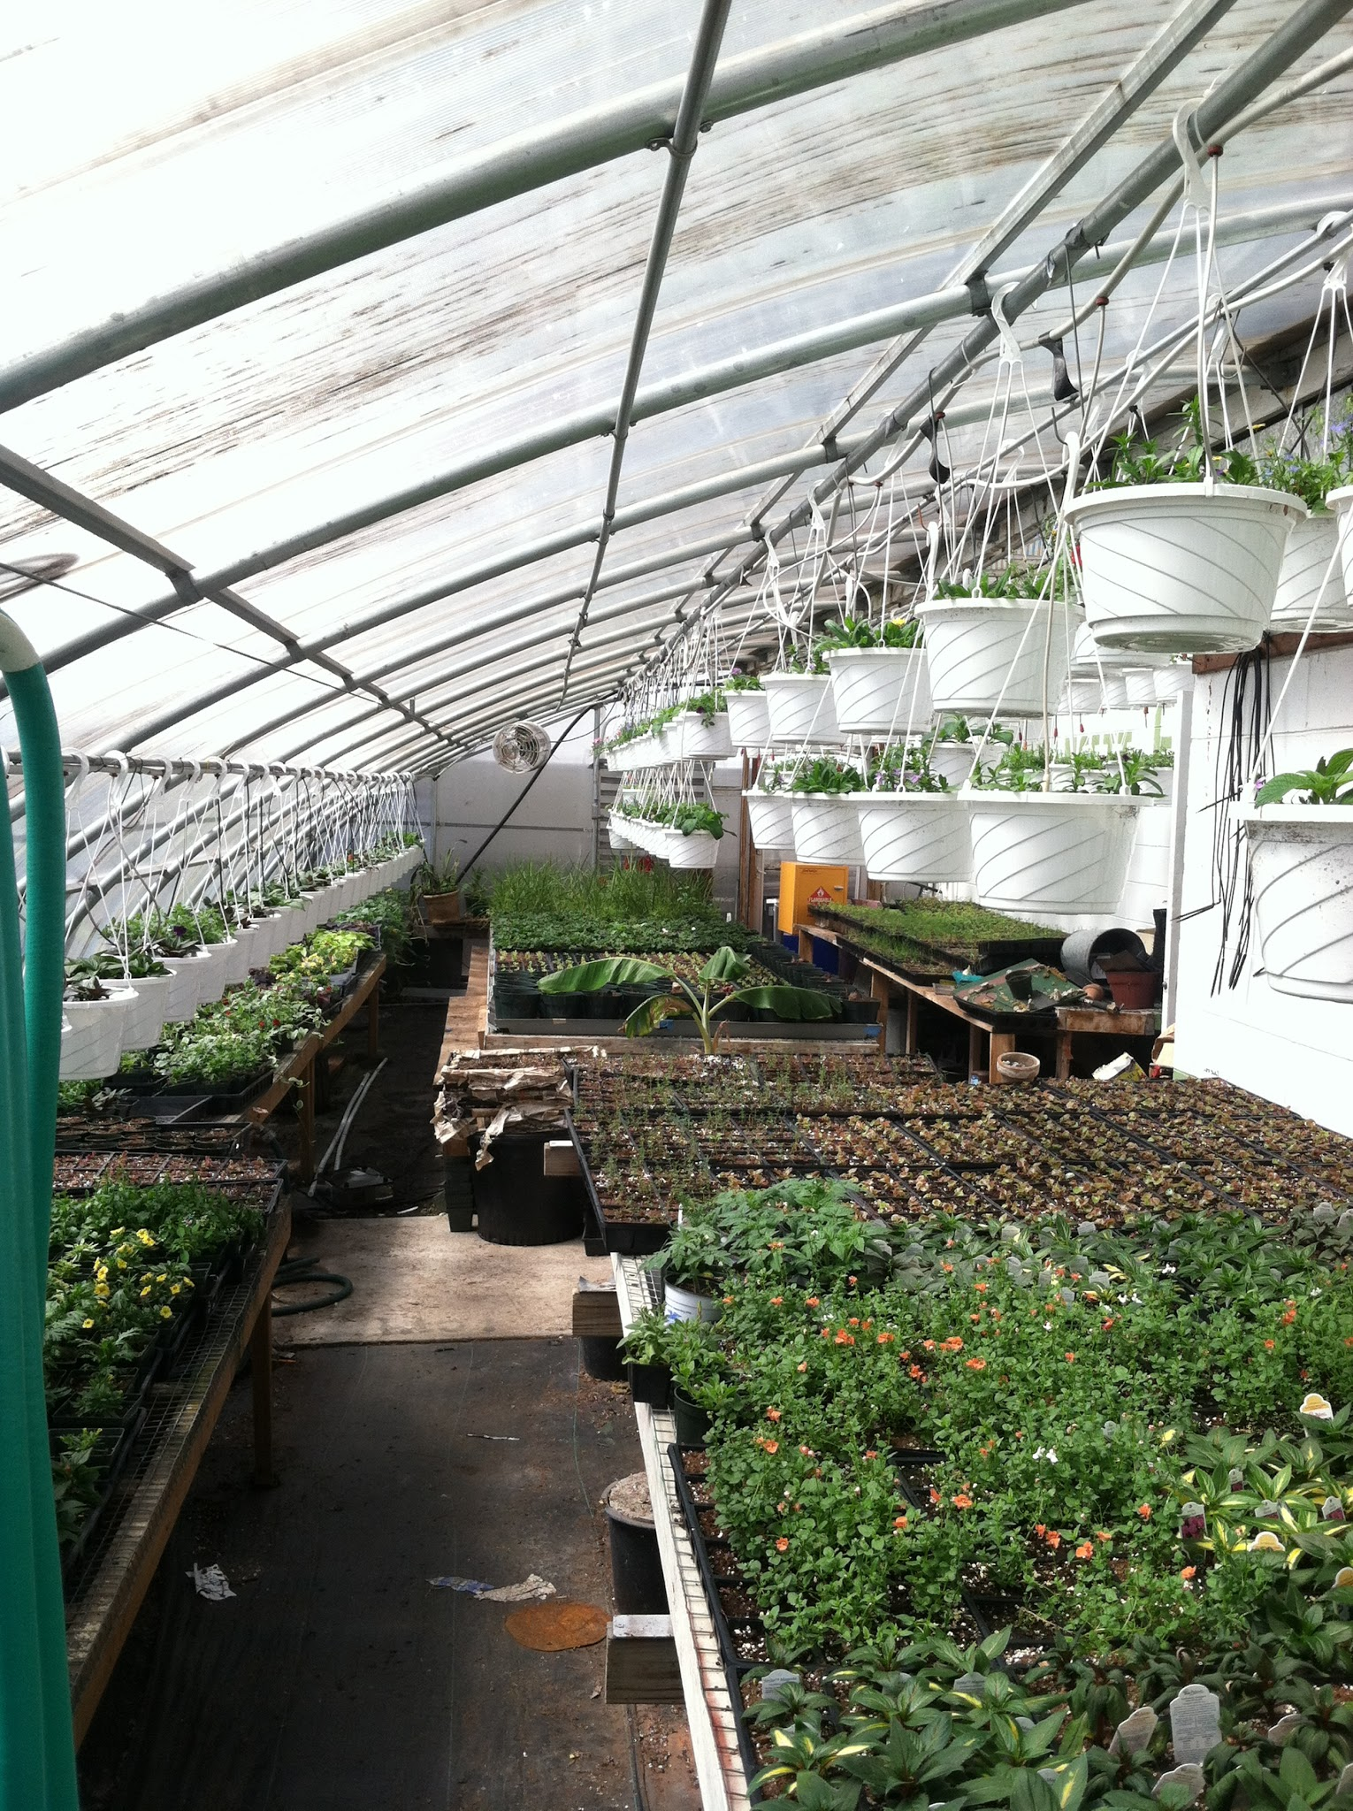
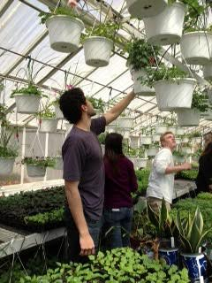
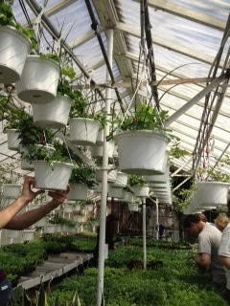
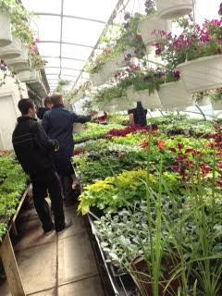
Our Greenhouses (in the spring):
At our annual plant sale in May, we open up the greenhouse to the public and sell the hundreds of plants that we grow. Our greenhouse is filled with all sorts of plants: geraniums, impatiens, petunias, tomatoes, peppers and many more. Students actively participate in planting, watering, pruning and selling our plant products.

Slide 4
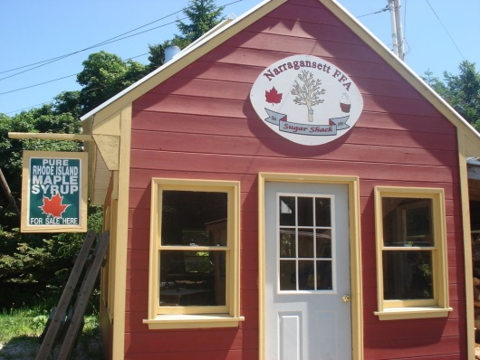
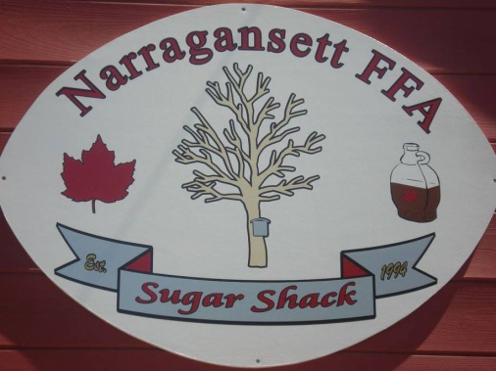
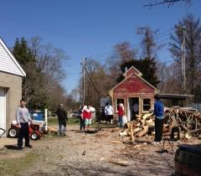
The Sugar Shack & Maple Syrup:
The Narragansett Sugar Shack was built in 2006 by students in the agriscience classes. During the winter months of February and March, we tap trees on campus and around the school property. With the sap that students collect, we embark on the process of transforming it into pure maple syrup. Students participate in the boiling, cleaning, and bottling process. The hundreds of bottles that we produce are sold to the public during the spring and especially at our annual plant sale.

Slide 5
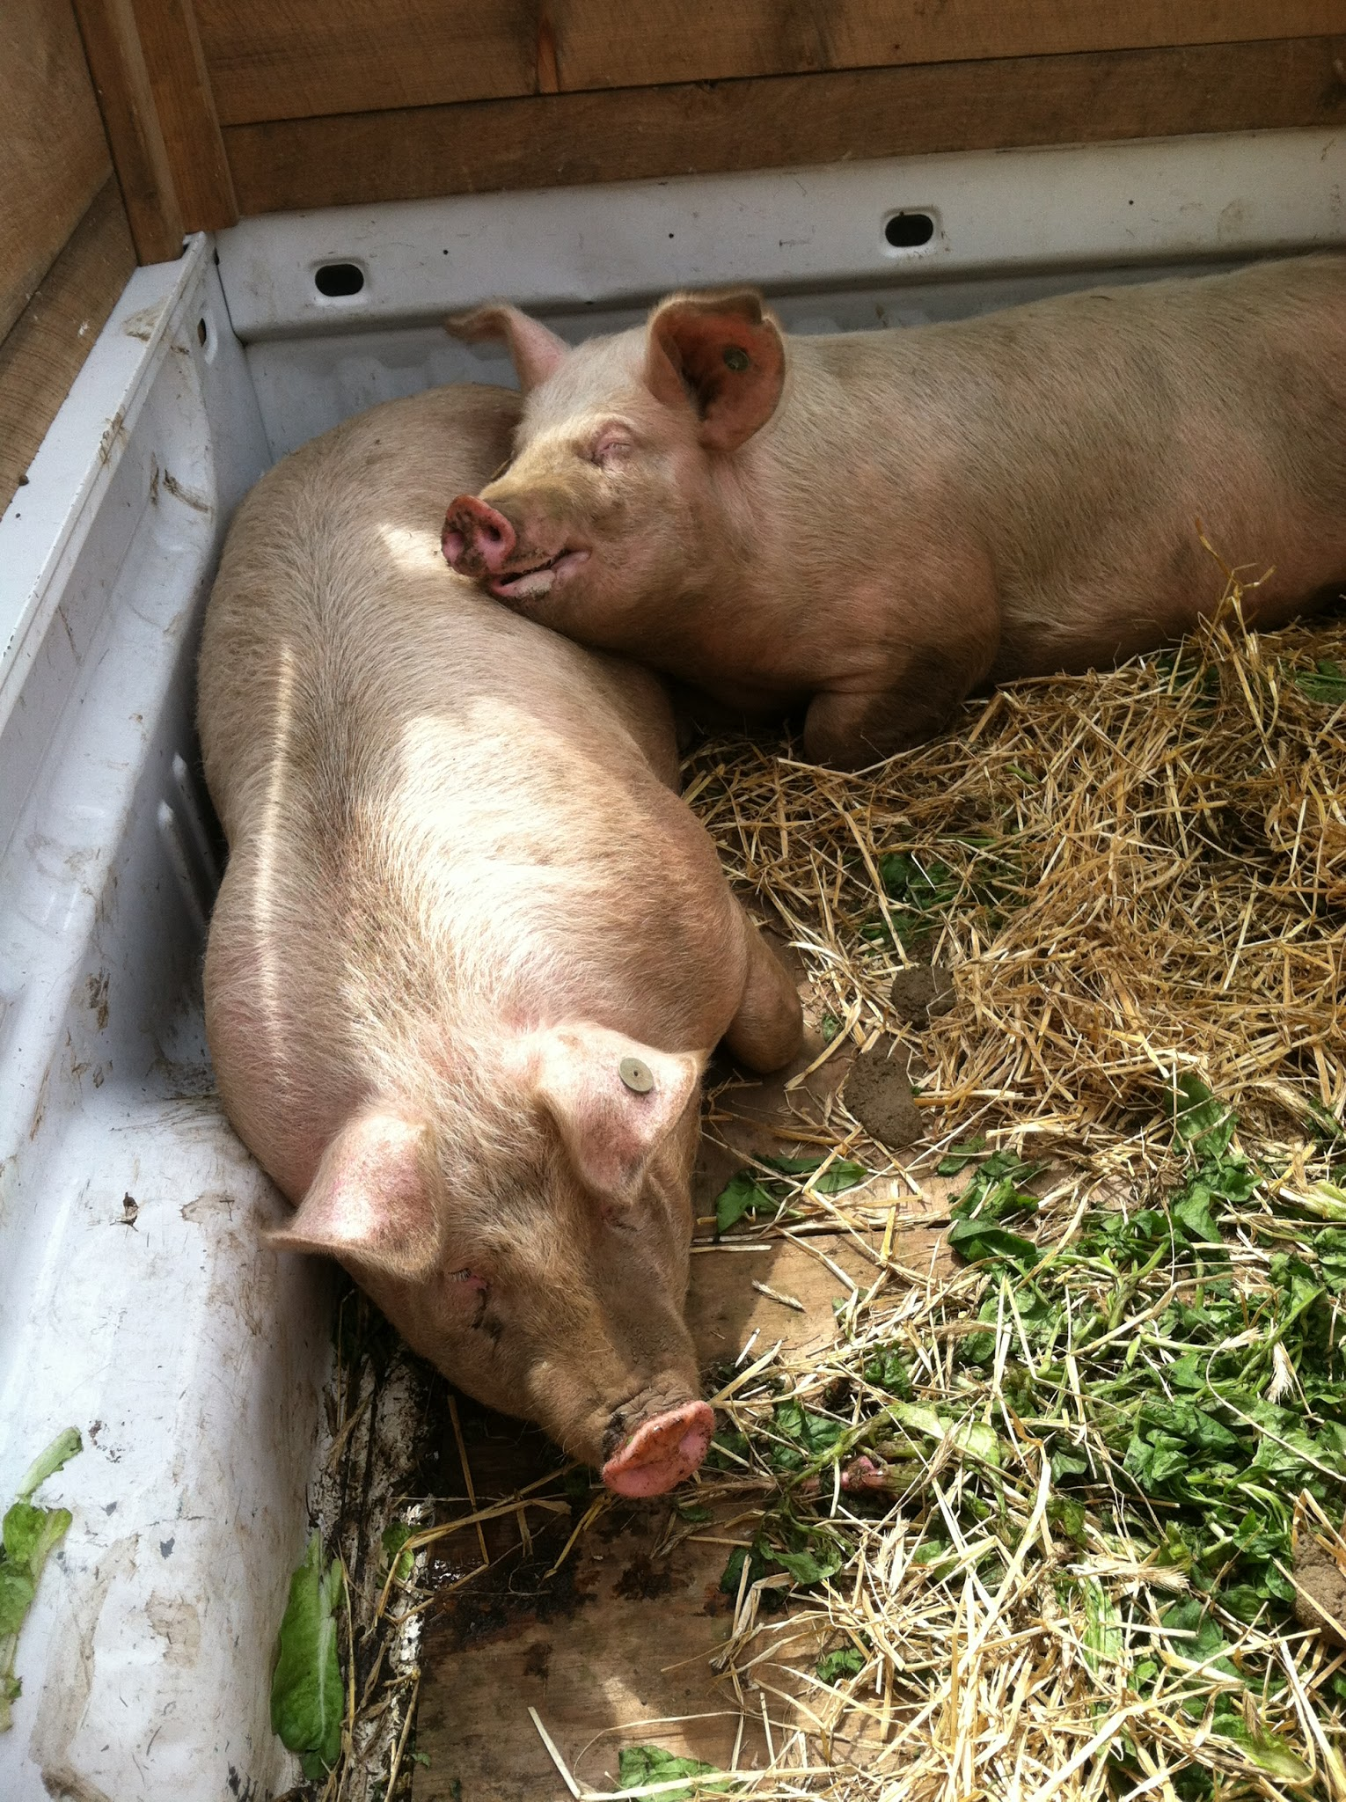
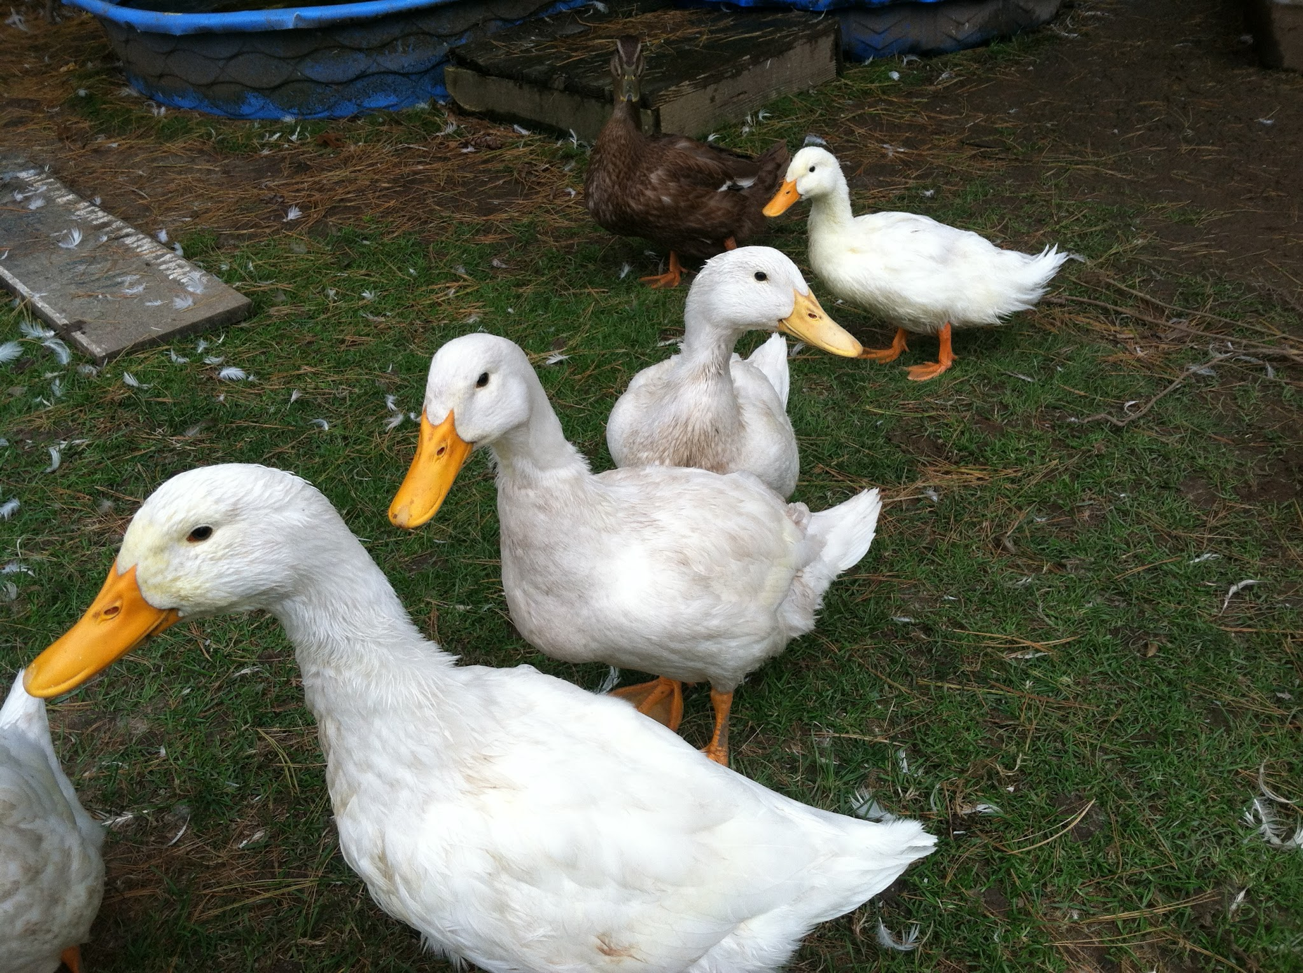
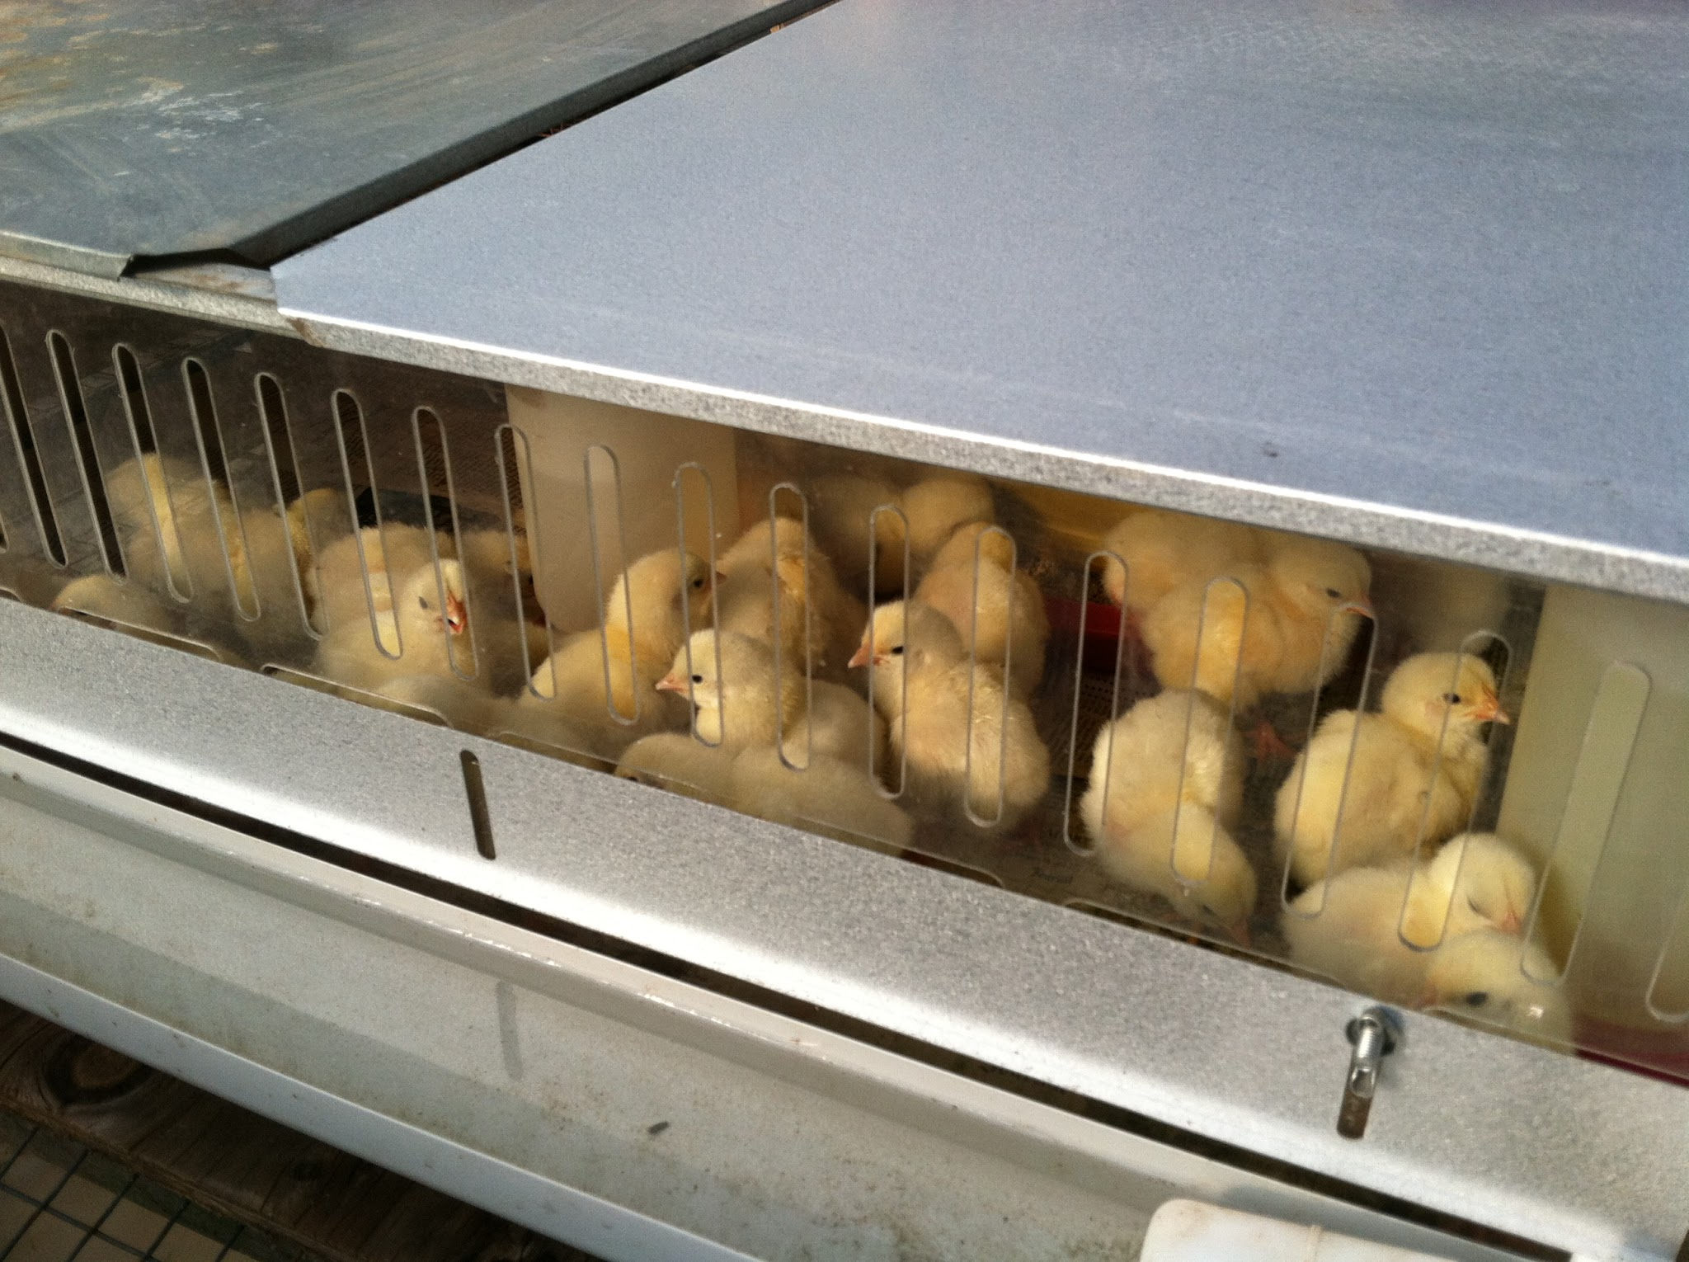
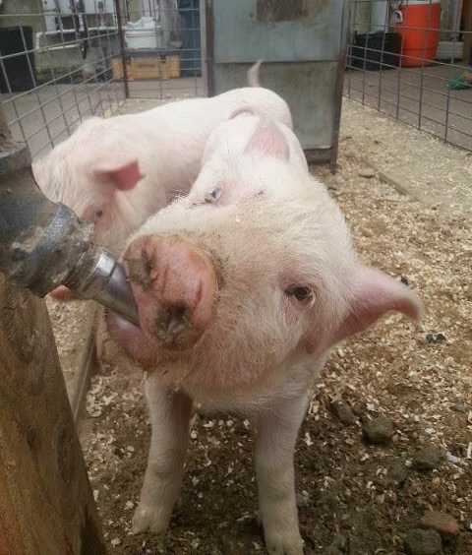
Animals:
Throughout the year, we house and raise many animals. From chicks to ducks to pigs, the students in the agriscience program participate in much of the caring for these animals. We are the only school in Rhode Island who has raised pigs, ducks and has our own poultry flock.

Slide 6
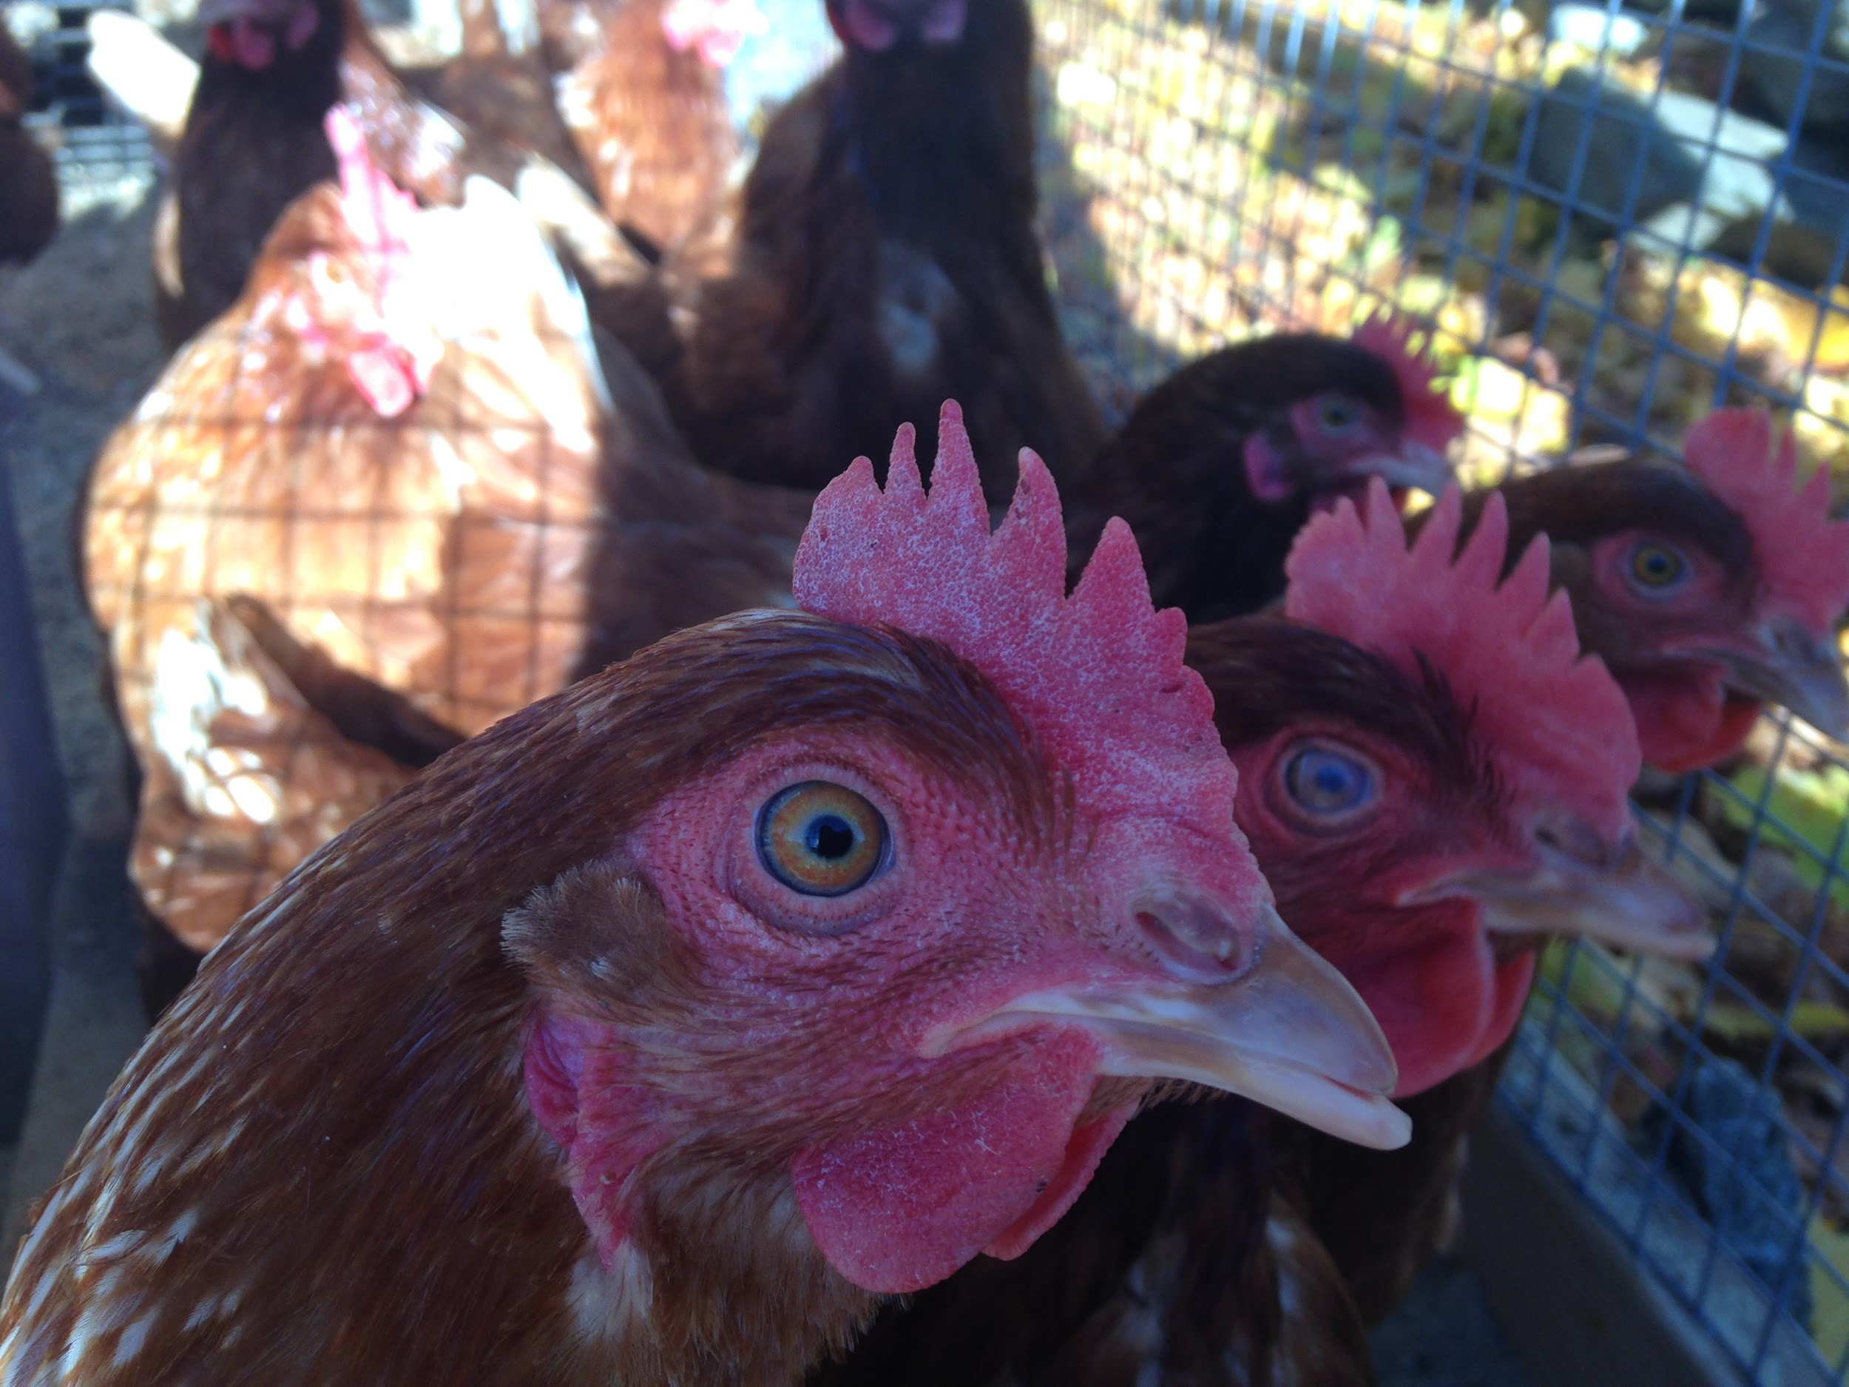
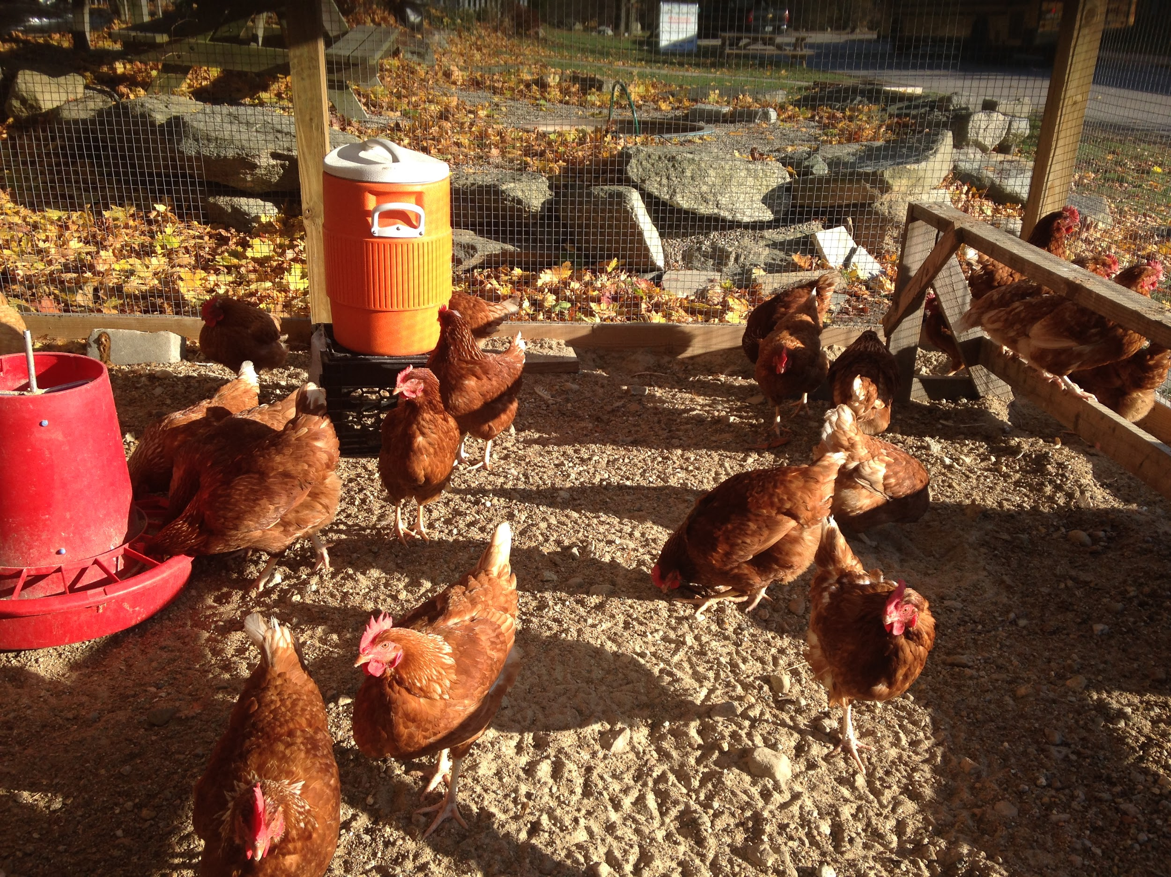
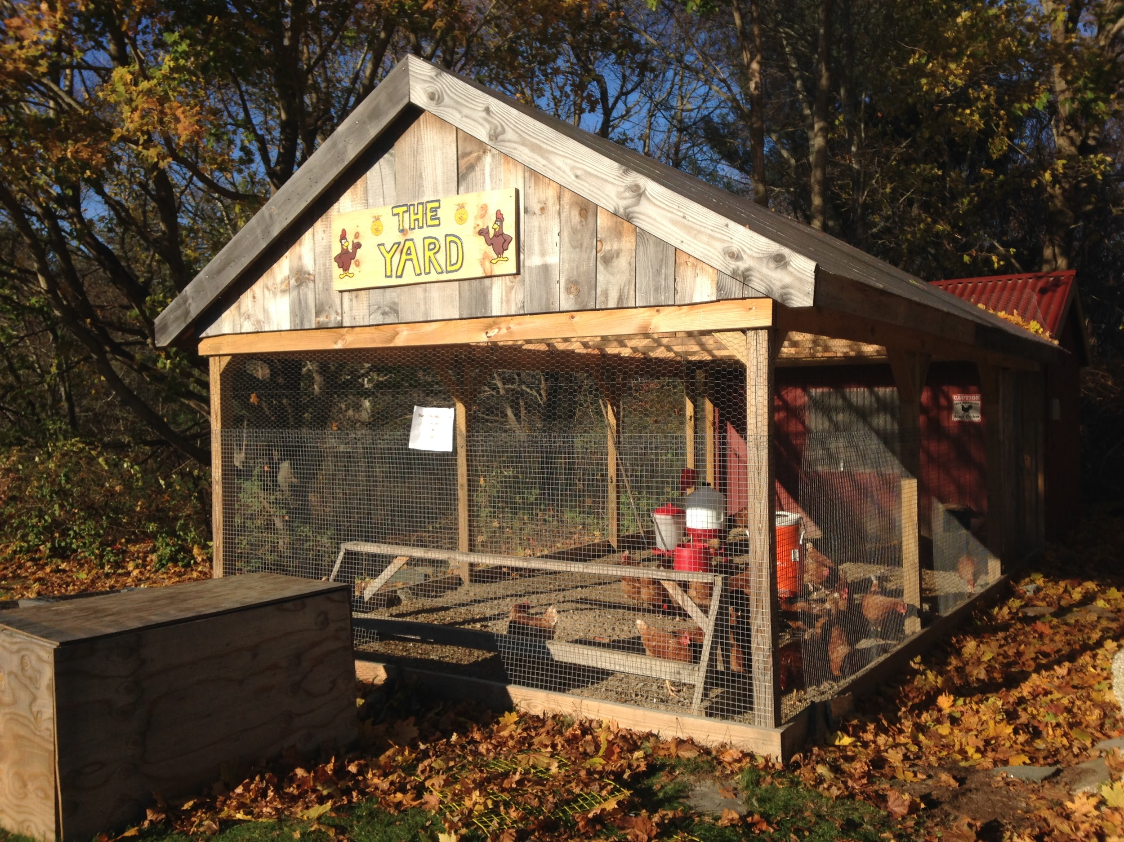
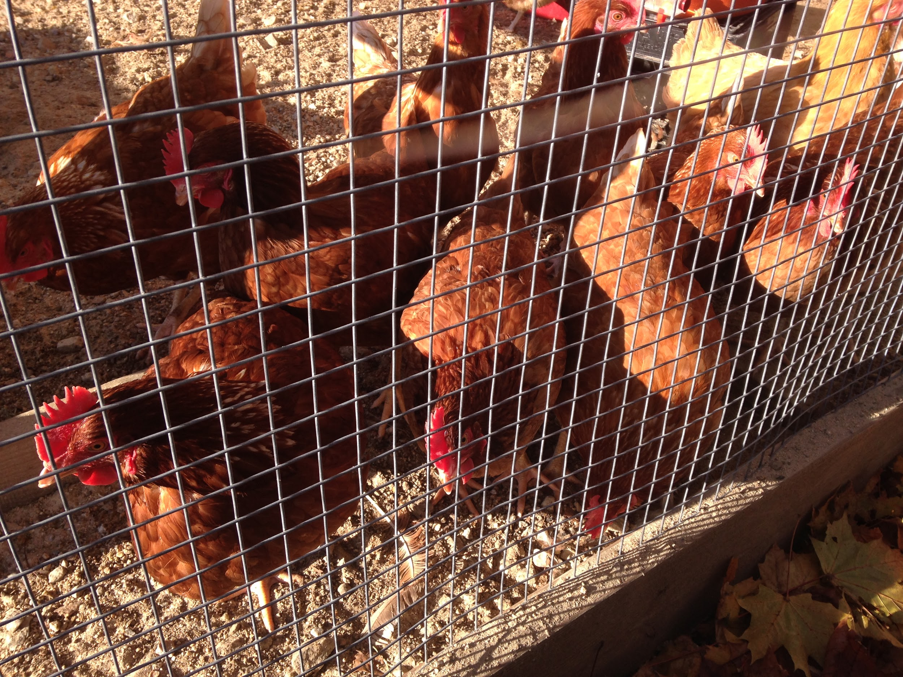
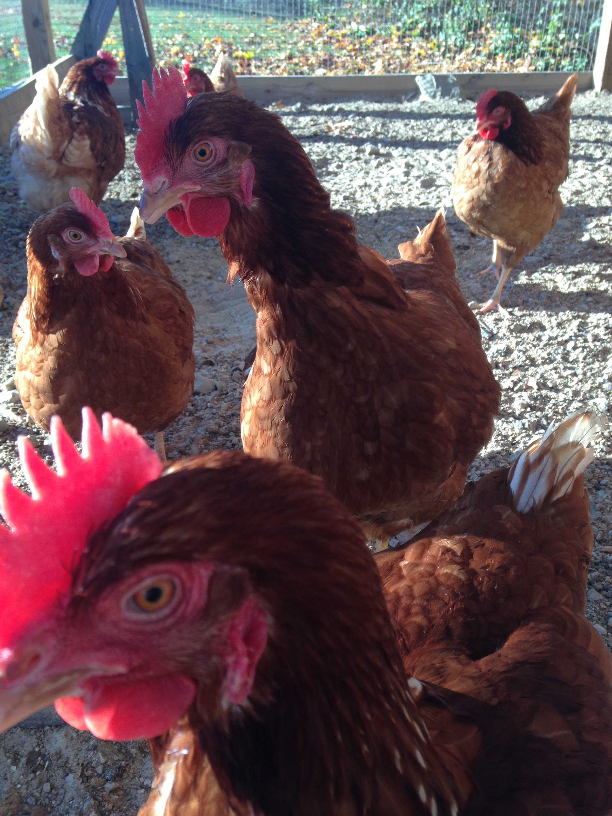
Chickens, Eggs & Fresh Egg Friday:
Raising the chickens and selling their eggs is a large part of our Ag program. The chicken coop was rebuilt in 2013 and houses 40 hens each year. About 3 dozen eggs are collected, washed, and packaged by students each day. These are sold to the public and also to students and teachers on “Fresh Egg Friday” every week.

Slide 7
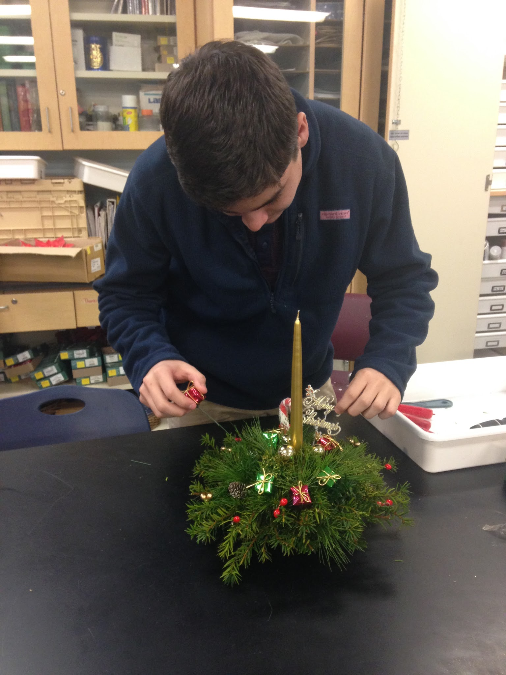
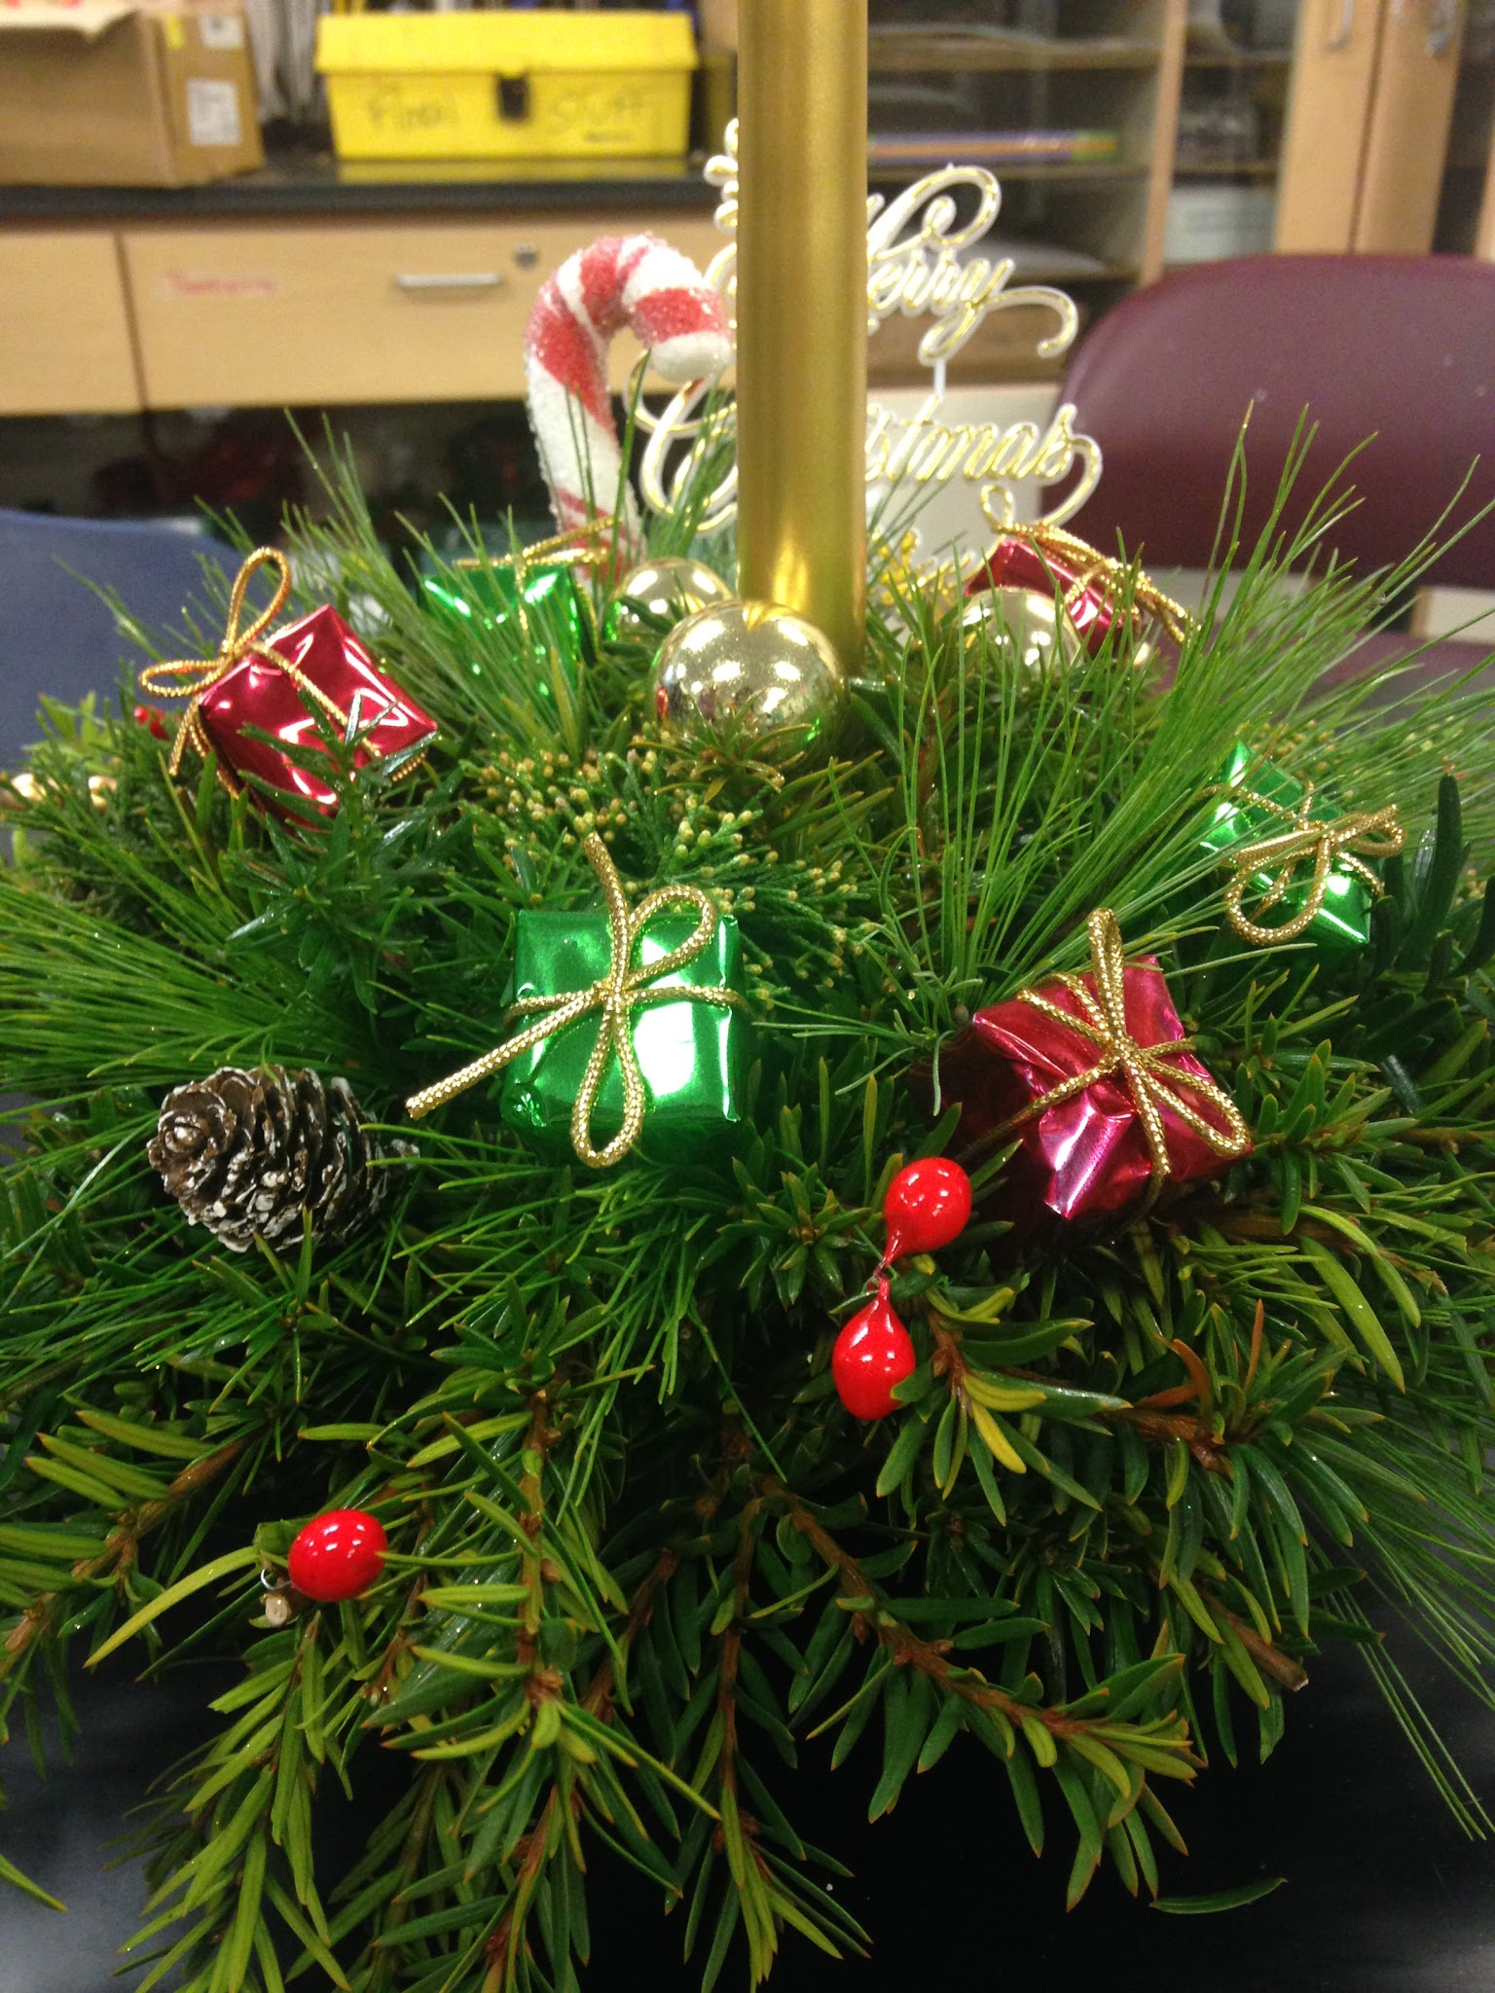
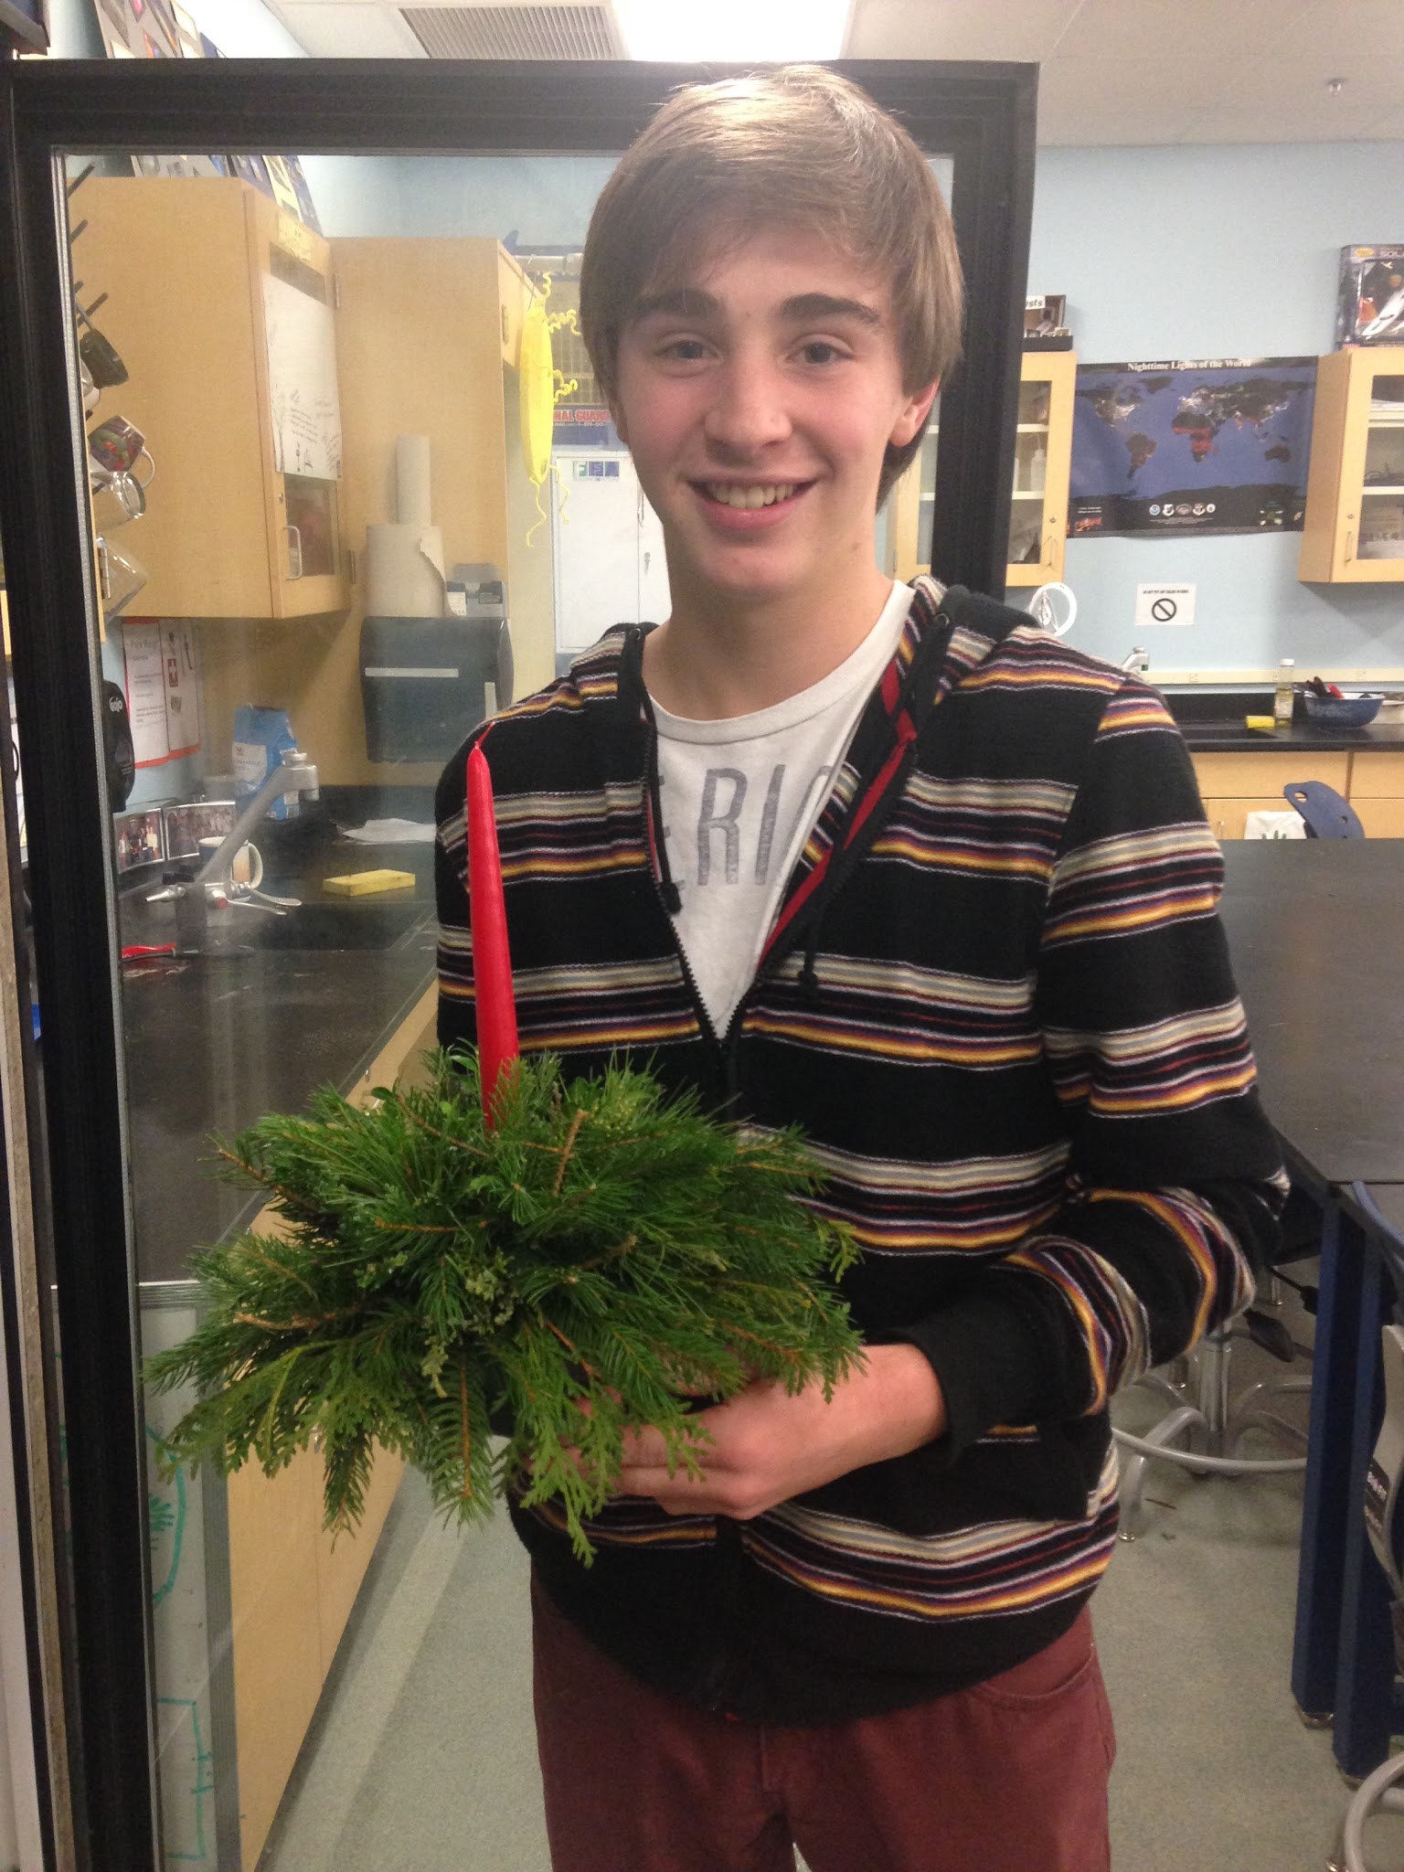
Holiday Floriculture:
In class and during their free time, students construct their own holiday centerpieces and accessories. Those who excel are able to compete in the annual floriculture competition in mid-December. Our teams and individuals have won local competitions and went to compete at the national level.

Slide 8
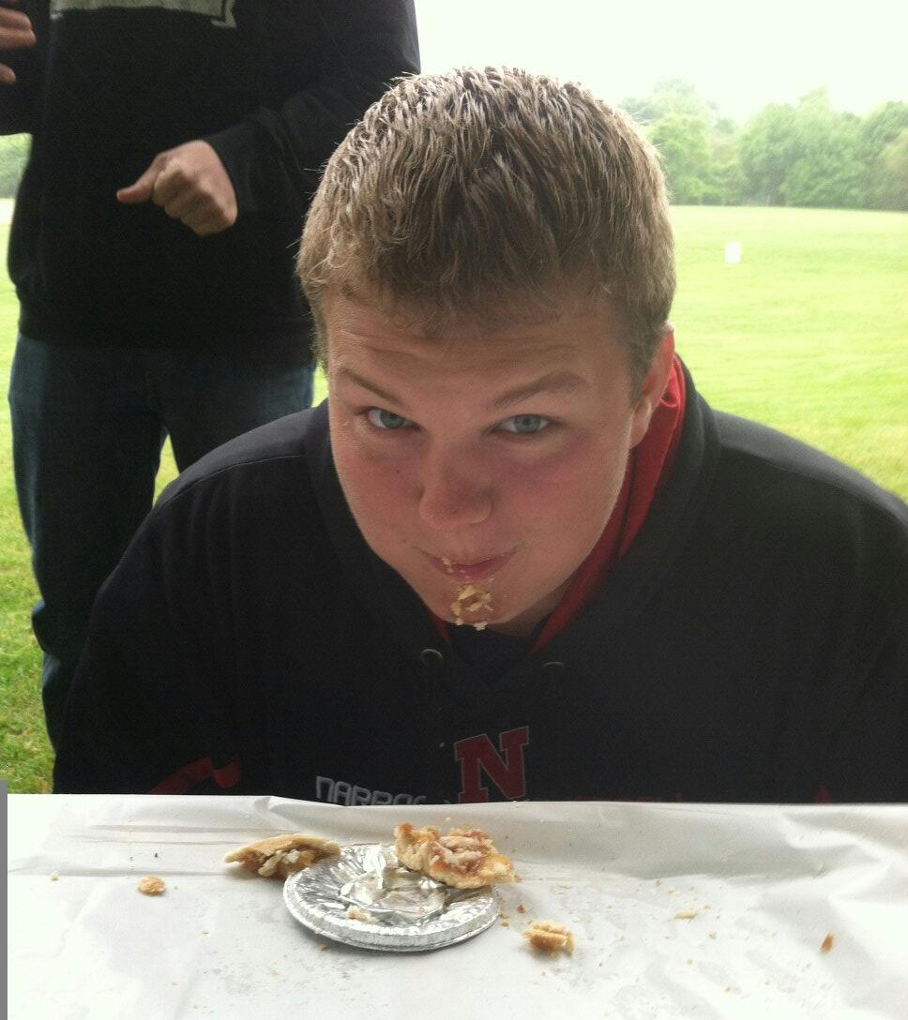
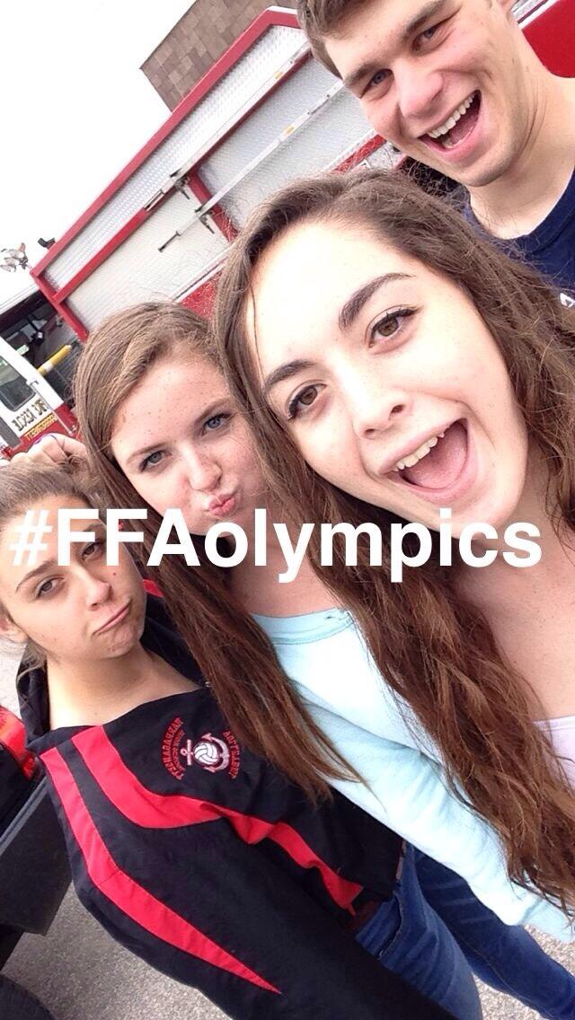
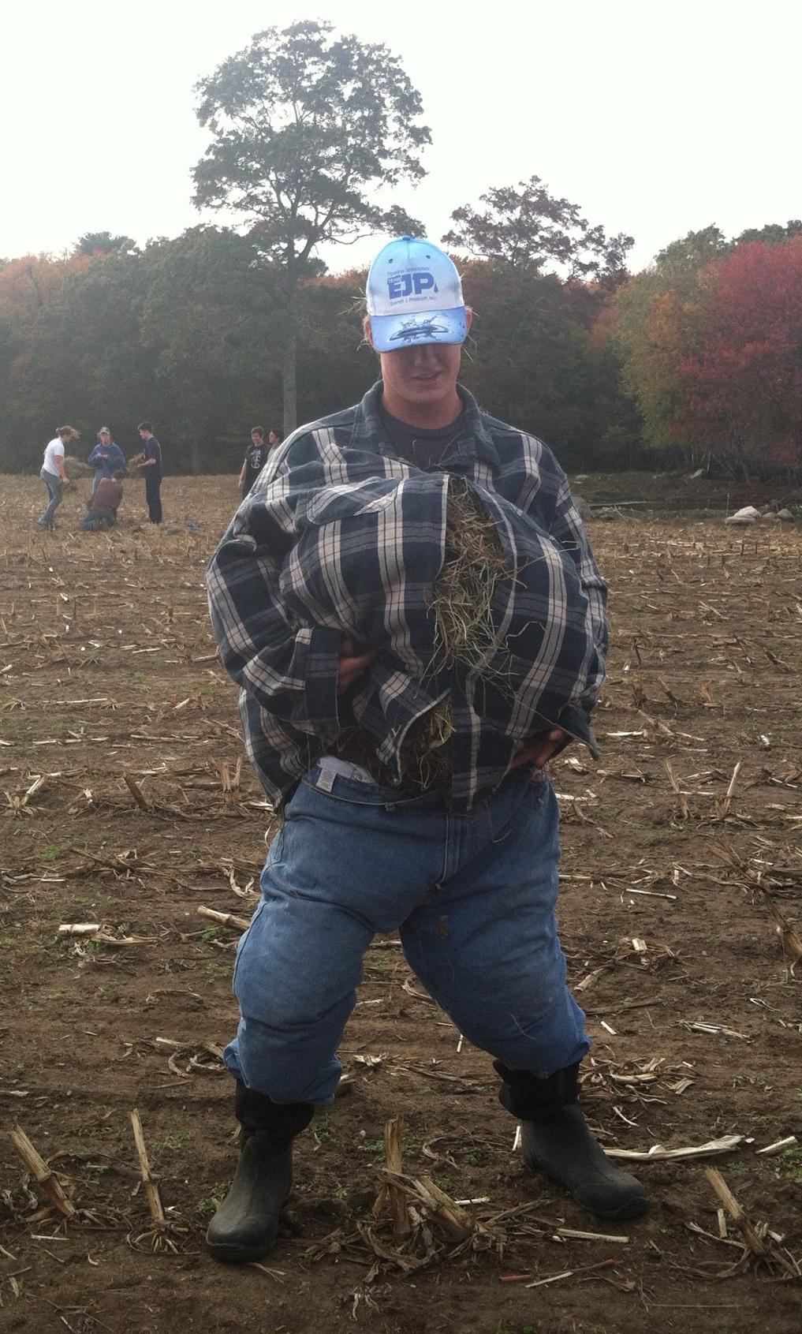
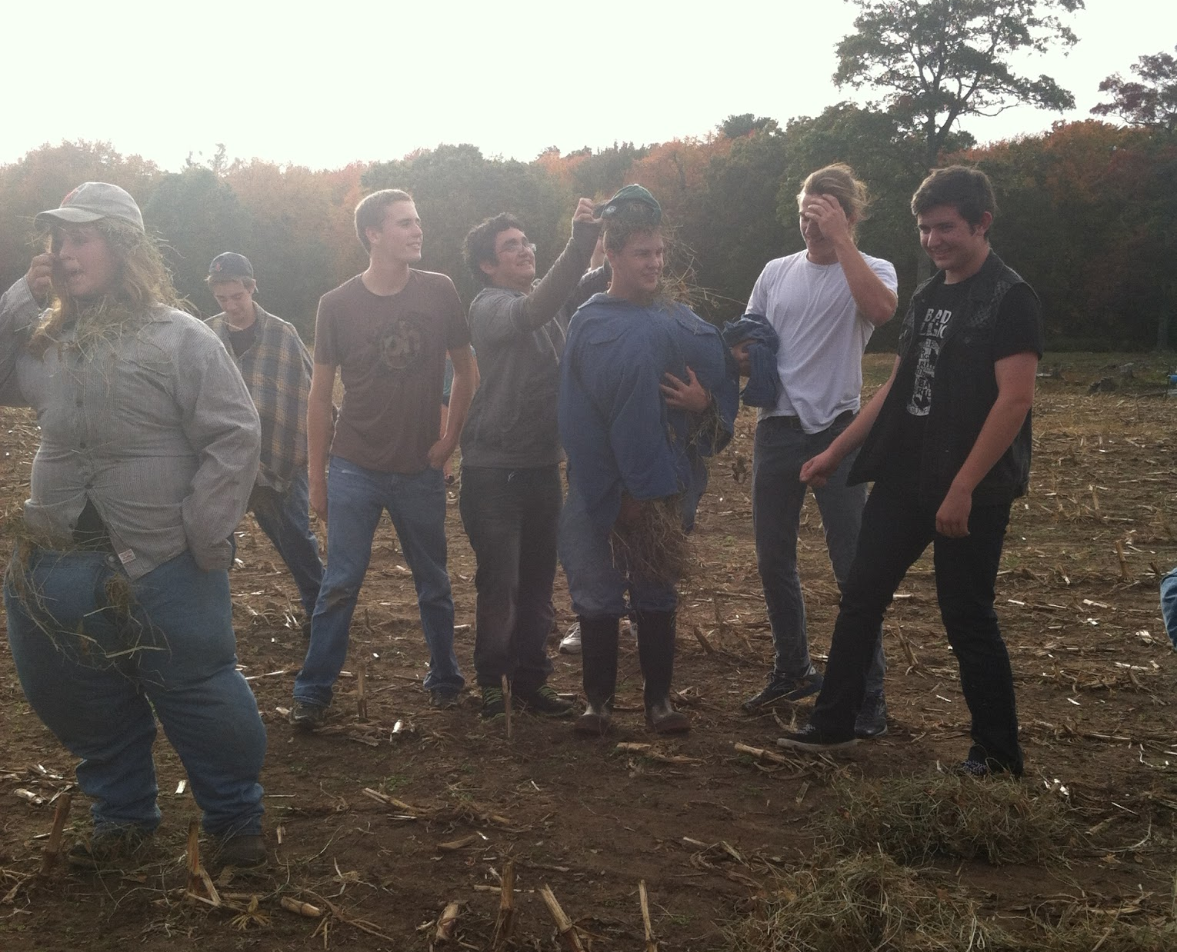
FFA Contests:
The Rhode Island FFA Association puts on 10 contests each year. Students from all over the state compete in pumpkin carving, floriculture, scarecrow building, ice cream making, and blind tractor driving (just to name a few).

Slide 9
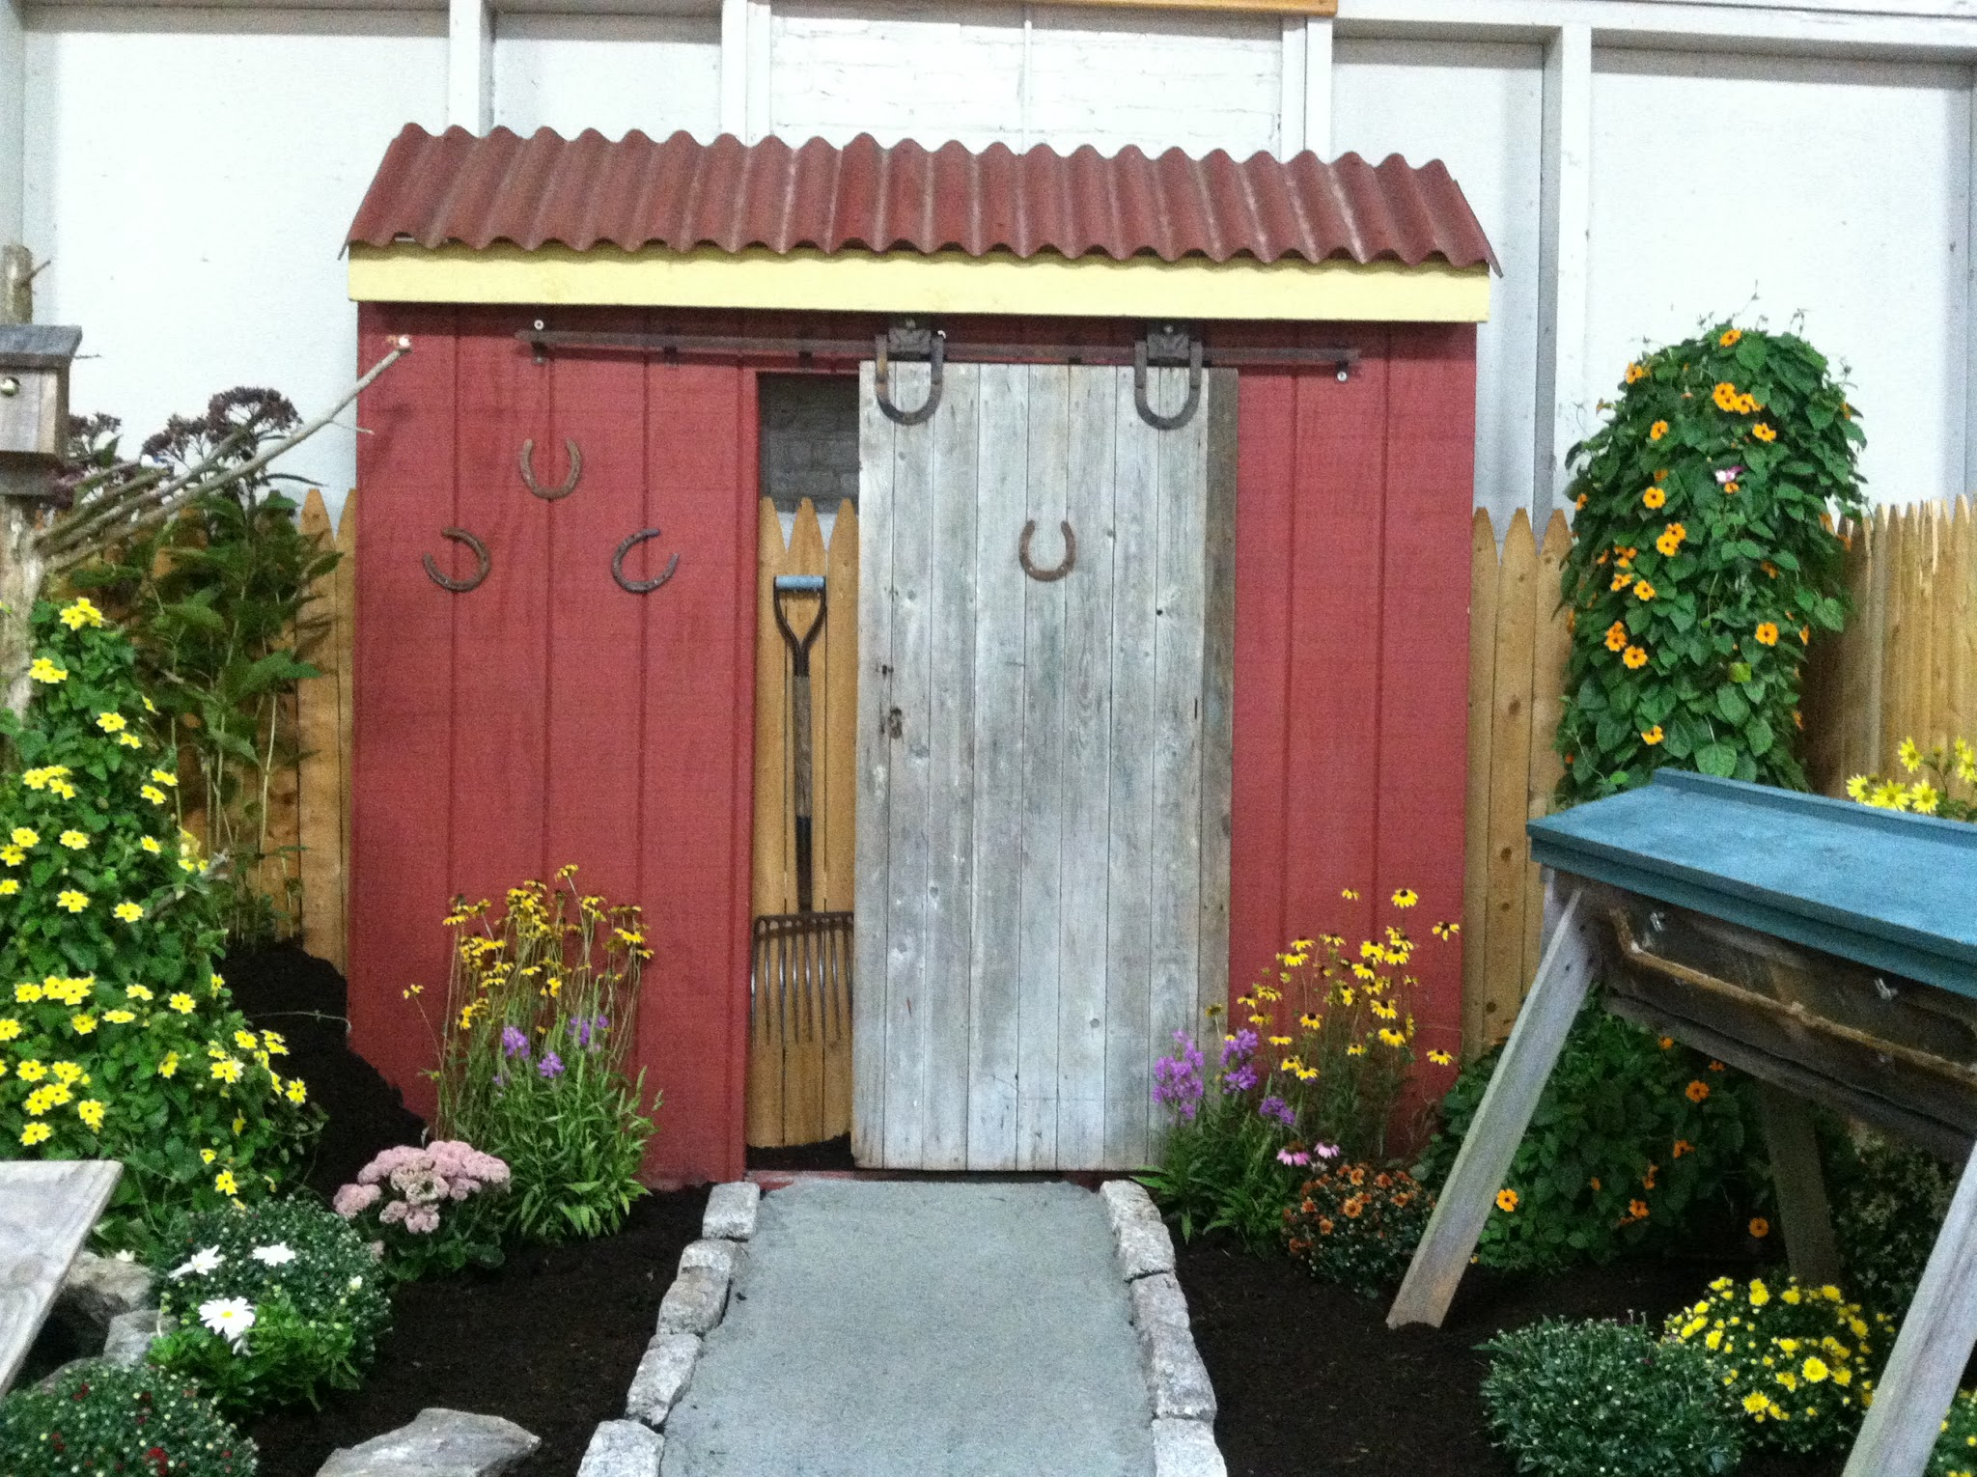
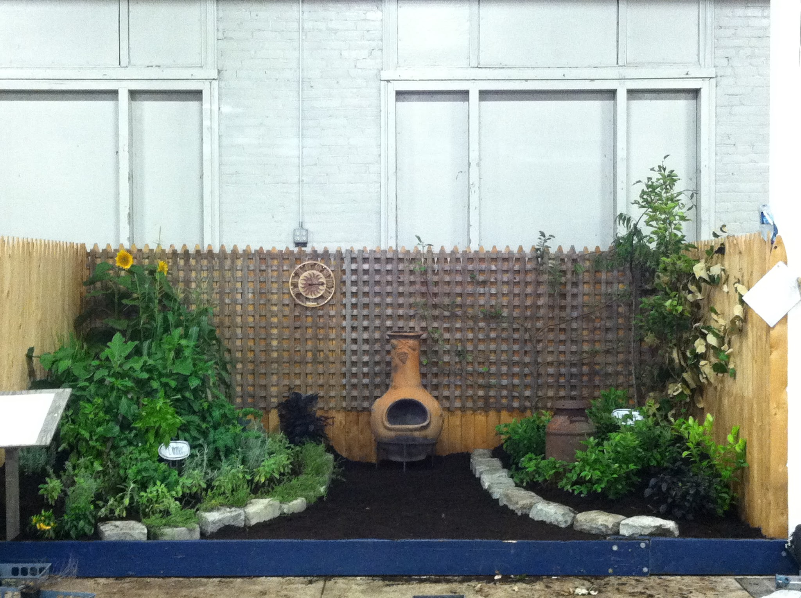
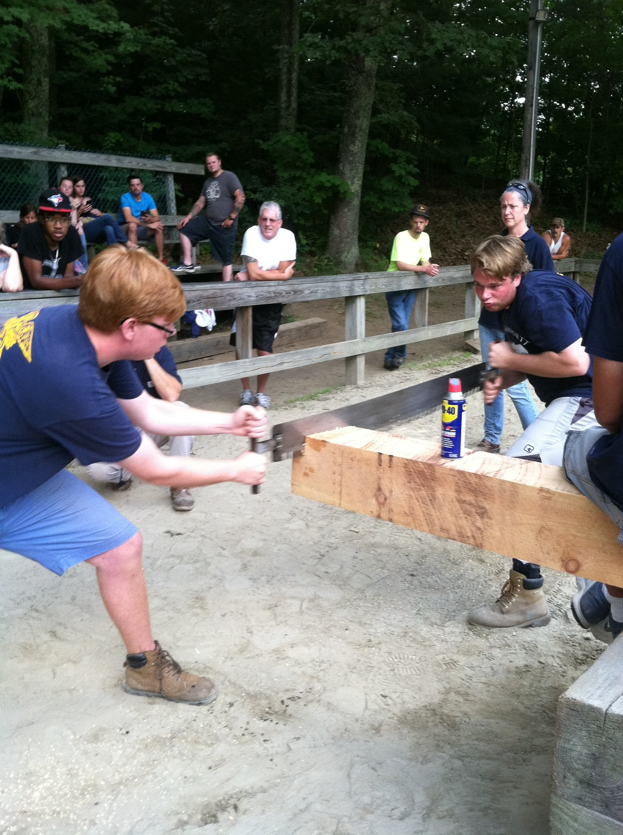
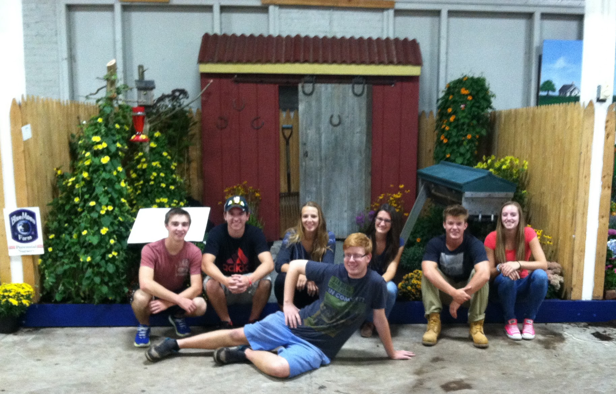
FFA Contests:
The landscape design contest is one of the biggest successes that the Narragansett Chapter has. Each year, we compete at the Washington County Fair and then go on to compete at the Big E Fair in Springfield, Mass. At the Washington County Fair, we also compete in the woodsmen contest.

Slide 10
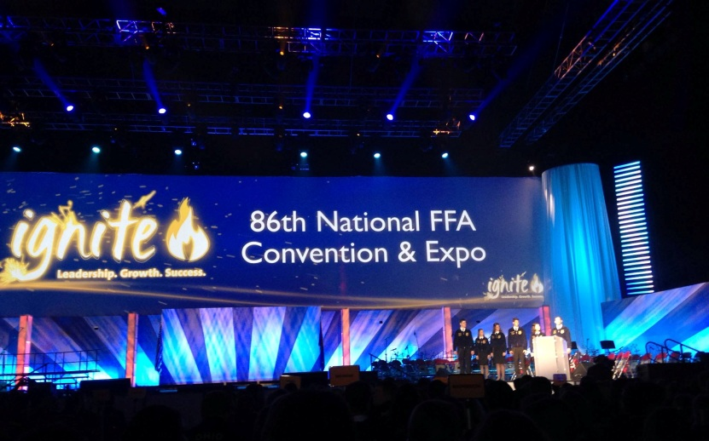
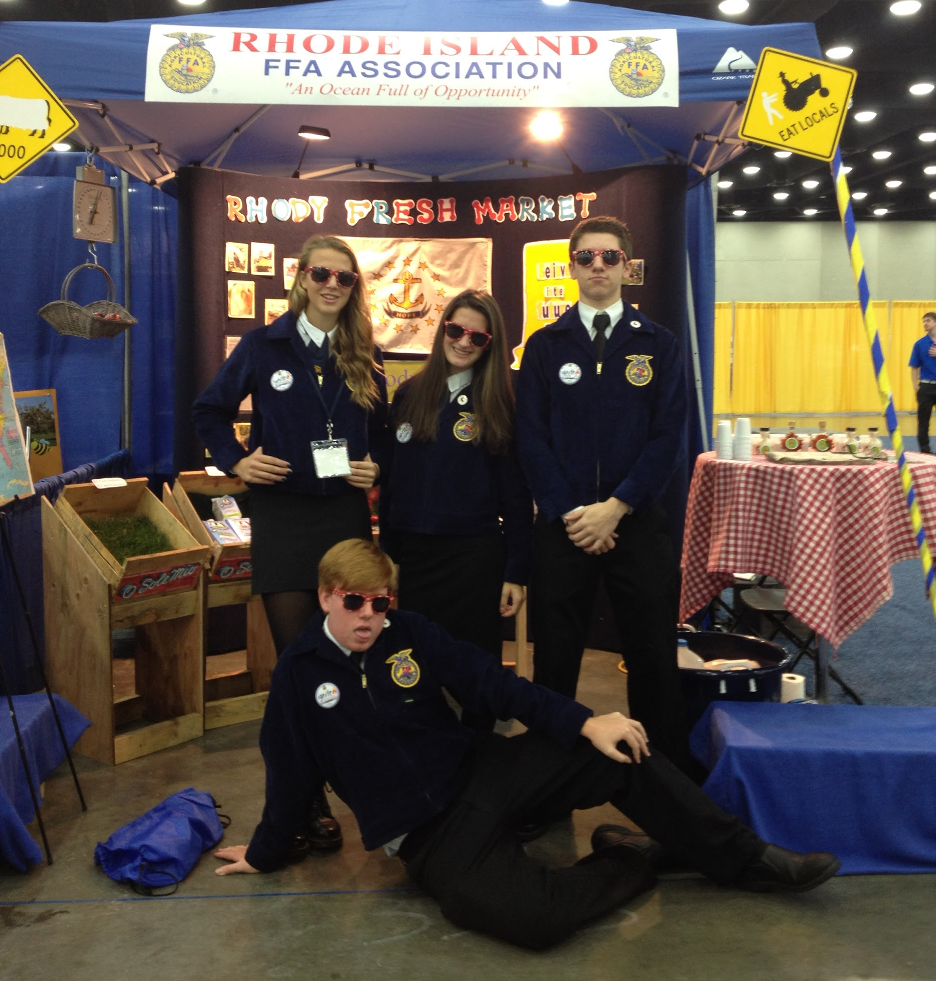
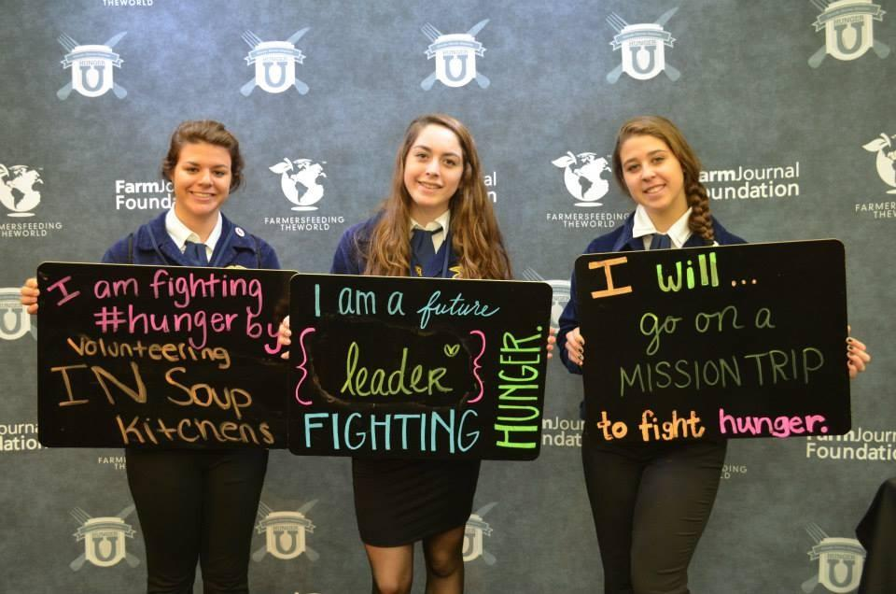
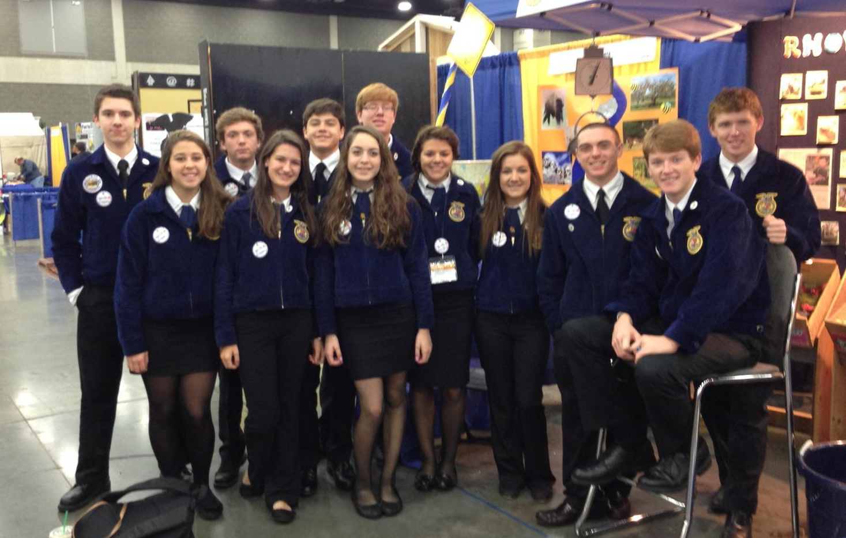
National Convention: (Louisville, Kentucky)
Each year, close to 15 students travel with our two agriscience teachers to the Future Farmers of America National Convention in Kentucky. Some participate in contest that they have previously competed in, others run the Rhode Island booth.

Slide 11
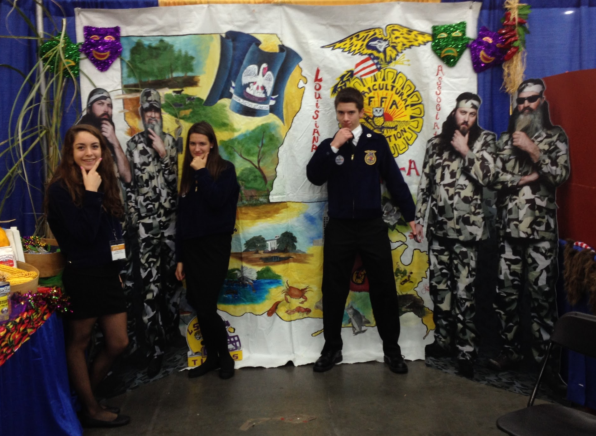
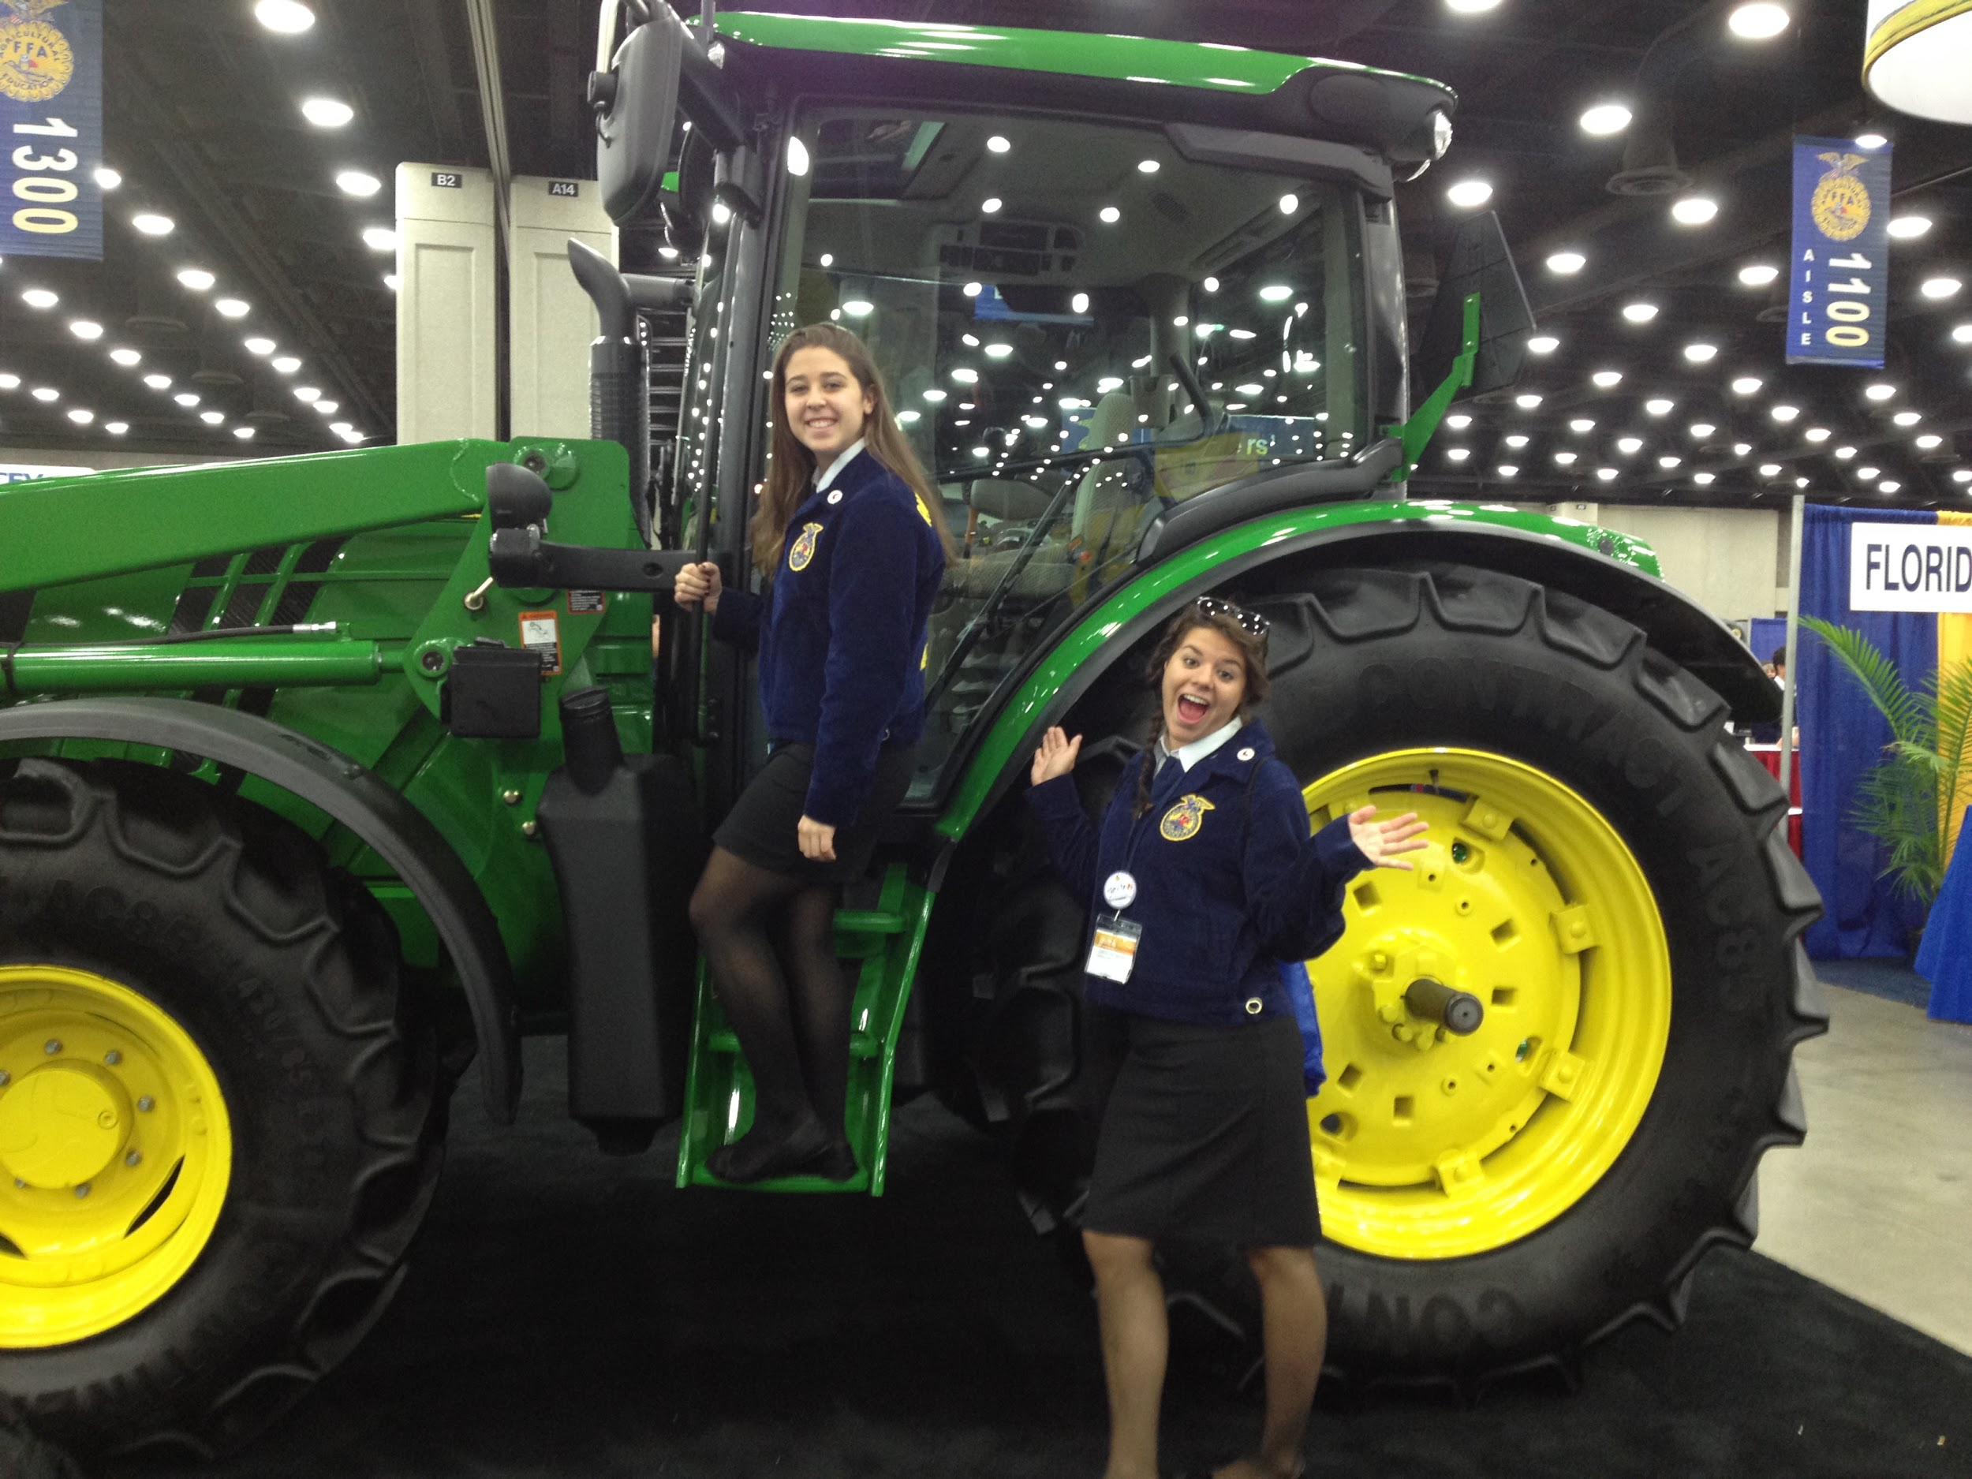
National Convention: (Louisville, Kentucky)
Students are able to meet other students and FFA members from each of the 50 states during this convention. They are able to experience the southern culture and form bonds with people that they may not usually talk to.

Slide 12
Our Agriscience program is one of a kind. We are the number one egg producing and maple syrup producing school. Narragansett is the only school in the state to have a functioning chicken coop, sugar shack and plentiful greenhouses.
The Narragansett Ag program has teachers who are dedicated to their students’ success in and out of the classroom. Skills learned in this program can be used throughout life and provide great insight into life after high school.

